Slide 1




LIVE WEBINAR !
May 21, 2020 10:00 AM in Central Time (US and Canada)
Anatomy of Cyberattacks on OT Networks.
Analysis of Famous Attacks.
Hosted by:
Ofer Shaked
Co-Founder and CTO
SCADAfence
Jared VanLandingham
Special Products Sales Engineer
Logic Inc

Slide 2
Ofer Shaked – Speaker Profile
Co-Founder & CTO of SCADAfence
13 years background in SCADA / Industrial Security
Ex-officer in the Israeli Intelligence Elite Cyber Unit
Architect in the OTCSA
Advisory Board member at ManuSec
Speaker at SANS Conference

Slide 3
Table of Contents
The OT Threat Landscape
MITRE ATT&CK Analysis Framework
MITRE ATT&CK for Industrial Control Systems (New in 2020)
Industrial Attack Components – A Technical Analysis of 6 Common Cyber Attacks
Common themes in industrial attacks
Attack Detection Demo
Security Strategy Goals

Slide 4

The Threat Landscape
2017
2018
WannaCry and NotPetya ransomware attacks hit OT environments, causing operational disruptions in automotive, food, pharmaceutical and other manufacturing plants
VPNFilter malware infects networking devices worldwide and searches for ICS communications
2020
2019
Iran Attacks Water Facilities
Iran launches cyber attacks on Israeli water facilities, targeting innocent civilains.
2016
LockerGoga ransomware attack halts production at global aluminium manufacturer Norsk Hydro
2015
Industroyer - for the second time, a targeted cyber-attack causes a blackout in Ukraine
A blast furnace at a German steel mill suffered "massive damage" following a cyber attack
2018
Chipmaker TSMC shuts down several of its factories after its systems were hit by a computer virus
2017
Triton/Trisis malware specifically designed to target Schneider Electric safety systems – hits mostly in the
Middle East
2014
2015
Dragonfly/Havex malware infects Industrial Control Systems (ICS) across the United States and Europe
Black Energy
ICS-specific malware left hundreds of thousands of homes in Ukraine without power
Due to collateral damage – any OT network can become the victim, even when it’s not the target:
Merck
Pharmaceuticals
$310 M
TSMC
Electronics
$250 M
Mondelez
Food & Beverage
$150 M
Reckitt Benckiser
Consumer Goods
$150 M
“SCADAfence has the right approach to help organizations ensure their OT networks are safe, reliable and secure” Darrell Stein, Former Global CIO, Reckitt Benckiser

Slide 5

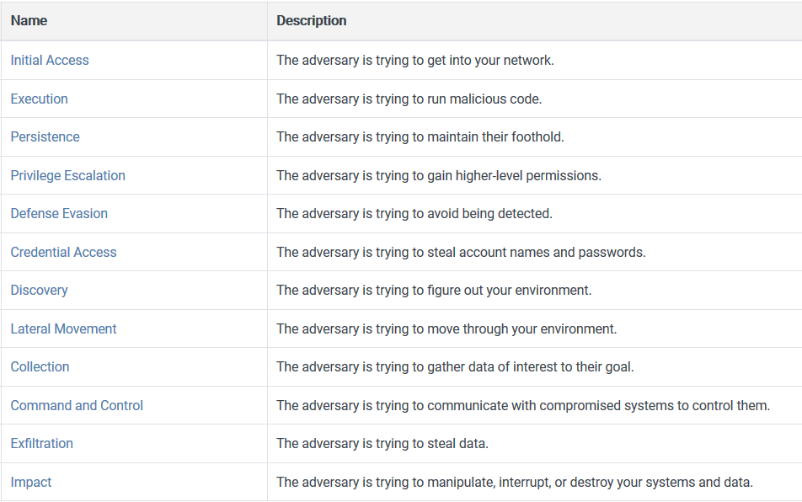

Slide 6
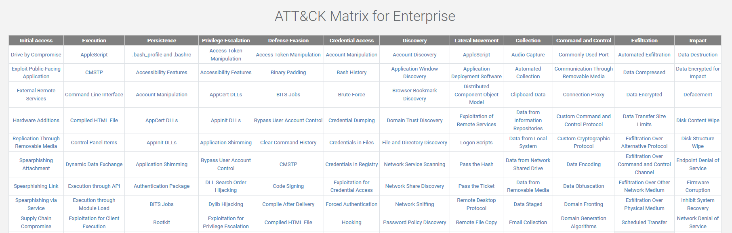

Slide 7
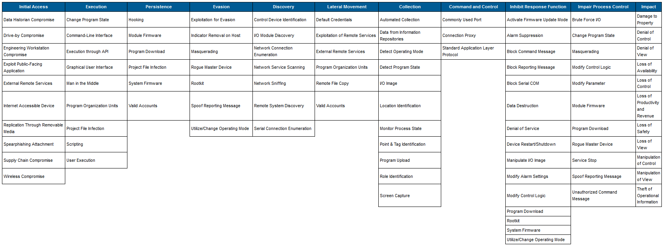
New (2020): for ICS

Slide 8
Industrial Attack Components
Name / Step | LockerGoga | WannaCry | Trisis | BlackEnergy | Industroyer | Havex
Initial access | Internet facing system | Infected PDF, others | N/A | Spearphishing | N/A | Phishing, waterholing
C&C | Yes | Kill-switch only | N/A | Yes | Yes | Yes
Discovery & Collection | N/A | SMBv1 TCP 445 Scan | Trisis protocol UDP 1502 Broadcast | IEC 104, ICCP, GE Cimplicity TCP 10212 scan | IEC 61850 scan (TCP 102) | OPC Scan
Lateral Movement | Compromised domain admin account | SMBv1 vulnerability (EternalBlue) | Trisis protocol UDP 1502 command | GE Cimplicity vulnerability | N/A | N/A
Impact | Global operations shutdown ransomware | Ransomware | Safety system bypass | DDoS, KillDisk, IEEE C37.118 message | IEC 104 Command | N/A (Data Exfiltration only)
Sources: SCADAfence Research, FireEye FIN6 analysis

Slide 9
Common Themes & Detections in Industrial Attacks
MITRE ATT&CK Step | MITRE ATT&CK Method | SCADAfence Detection
Initial Access | Known/Unknown Connectivity | Exposure Analysis map & alerts
Initial Access | Travelling infected computers | Baseline - New host, Foreign host
Discovery | Network Service Scanning | IP, TCP, UDP, etc anomalies
Lateral Movement | Exploitation of Remote Services | Vulnerability detection Binary exploitation detection Protocol Violation
Command and Control | Standard Application Layer Protocol | Malicious IP/Domain
Inhibit Response Function | Program Download | Baseline - PLC Programming Change
Impair Process Control | Service Stop | Baseline - PLC Stop
Impact | Process sabotage | Baseline - Value-Level Anomalies

Slide 10
Attack Detection Demo

Slide 11
Security Strategy Goals
A well-prepared network is…
Very difficult to attack
Slows down the attackers, allows the defenders to respond
If attacked, it results in minimal damage and quick recovery

Slide 12
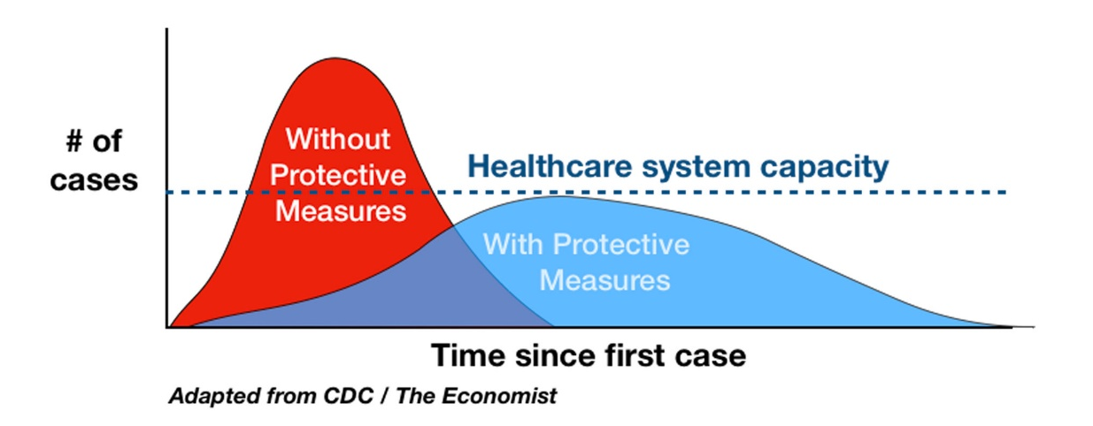
Network Segmentation is Social Distancing for Network Assets
Network Monitoring is Viral Testing for Network Assets
Malicious Activity
Response Time
Naïve
Network
Protected Network
Attack starts
Response starts
Efficient response
Inefficient response
Time

Slide 13


Q&A

Slide 14
Thank You!
Ofer Shaked
Co-Founder & Chief Technology Officer,
SCADAfence
ofer@scadafence.com
Jared VanLandingham
Special Products Sales Engineer
Logic Inc
jared@logic-control.com

