Slide 2
The Future of HMI/SCADA
John Krajewski
Director of Product Management
HMI/SCADA

Slide 3






Wonderware HMI SCADA Landscape by Scale
Products
Machine
Process
Plant
Site
Enterprise
Community of Experts
Key Needs
Ease of Use
Visualization
Alarming
Basic History
Connectivity
Larger Tag
Standards
Extensible
Reporting
Management
Remote Control & Monitoring
Server
Equipment Model
Thin Client
Central Historian
Fault Tolerance
Situational Awareness
HMI/Common Control Room
Advanced Alarm Mgt
Concurrent Engineering
Common Standards
Distributed Historians
Operational Centers
Information Mgt
Distributed Sites/ Multi-site
Corporate Engineering
Knowledge Mgt
Multi-platform devices
Collaboration
Cloud History
Increasing Functional Capabilities
InTouch Machine Edition
InTouch
Wonderware System Platform
InTouch
Access
Anywhere
InTouch
Panel PC
Wonderware
Alarm Adviser

Slide 4

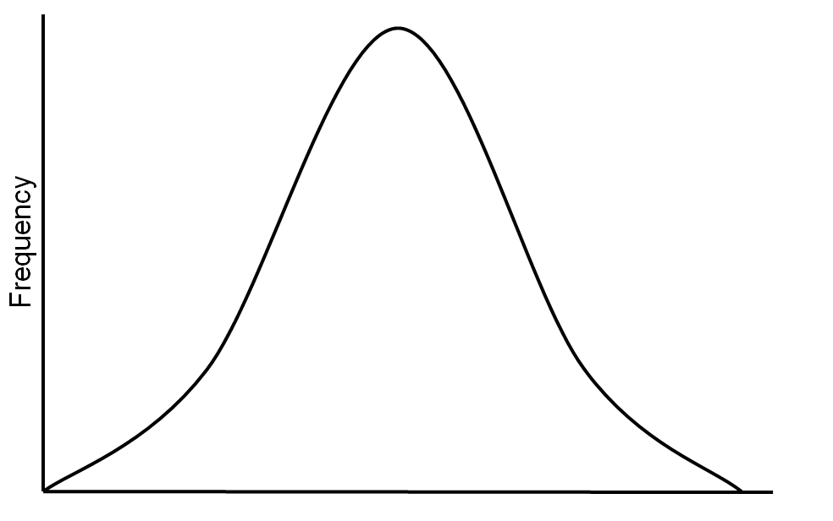
Natural Execution Evolution
Average Life Span of an HMI/SCADA Application is 15 years.
Organizations
Execution Model Maturity

Slide 5
Industrial Execution Models
PEOPLE
OWNERSHIP
BELIEF
COMPLIANT
TRAINED
EMPLOYED
UNIFIED
DISTRIBUTED
CONNECTED
ISOLATED
MANUAL
OPTIMIZED
QUANTITATIVELY MANAGED
MANAGED
DEFINED
AD HOC/REACTIVE
TECHNOLOGY
PROCESS
EXECUTION
MODEL
ADAPTIVE
REINFORCED
CONSISTENT
PREPARED
REACTIVE

Slide 6
Market Drivers for HMI SCADA
Mobility
Situational Awareness
IT/OT Convergence
Securing SCADA
Life Cycle Management
Leveraging Information/ Big Data
Industrial Internet of Things
Modernization

Slide 7
Mobility

Slide 8
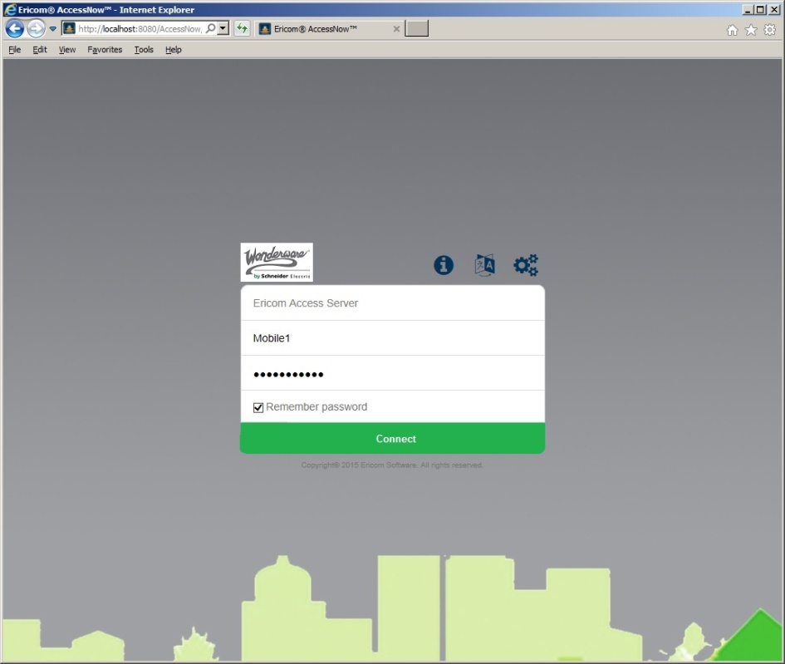

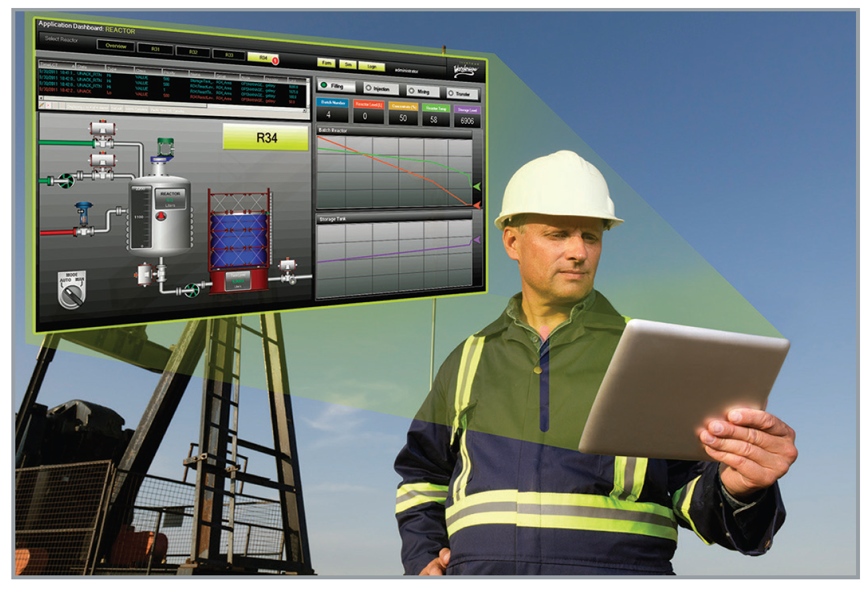
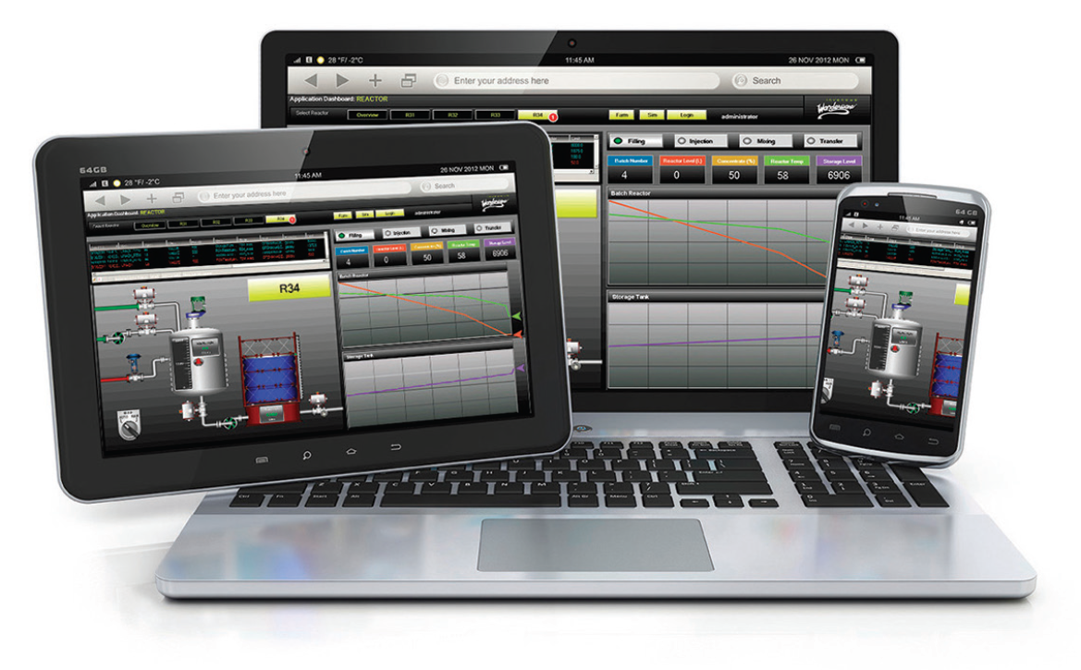
Mobility – HMI/SCADA
2014 R2 SP1

Slide 9


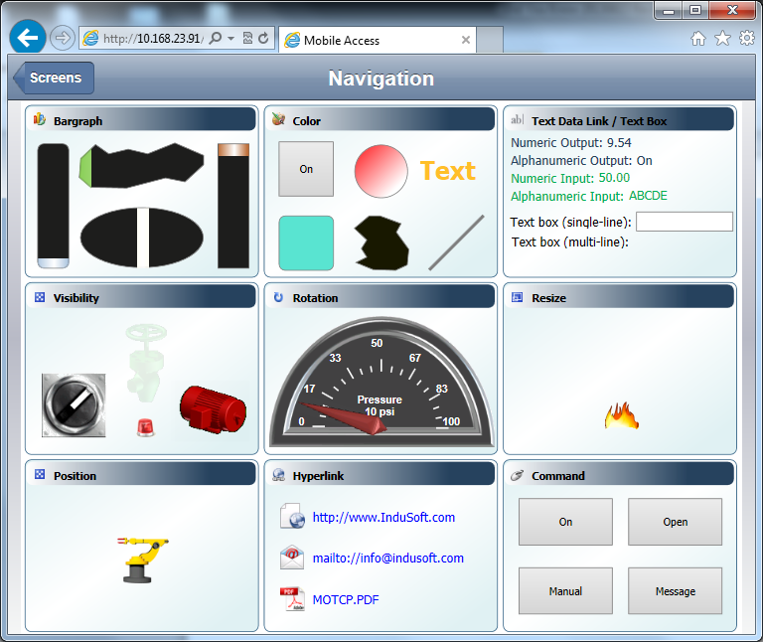
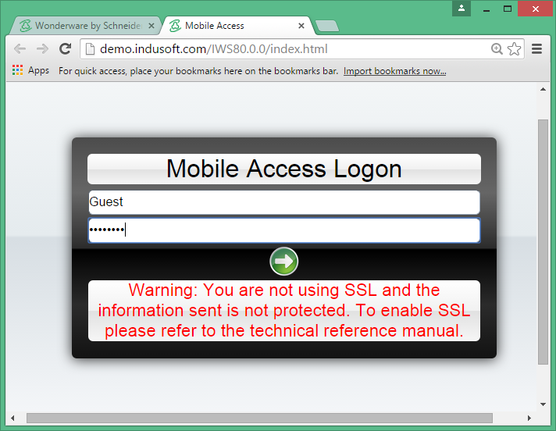
Mobility – HMI/SCADA
InTouch Machine Edition 2014 R2

Slide 10
Situational Awareness

Slide 11

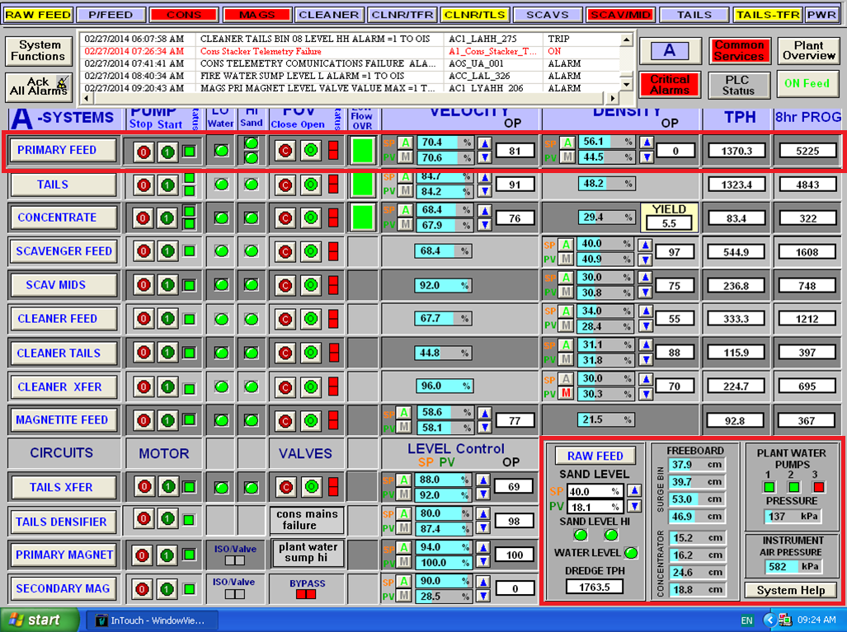
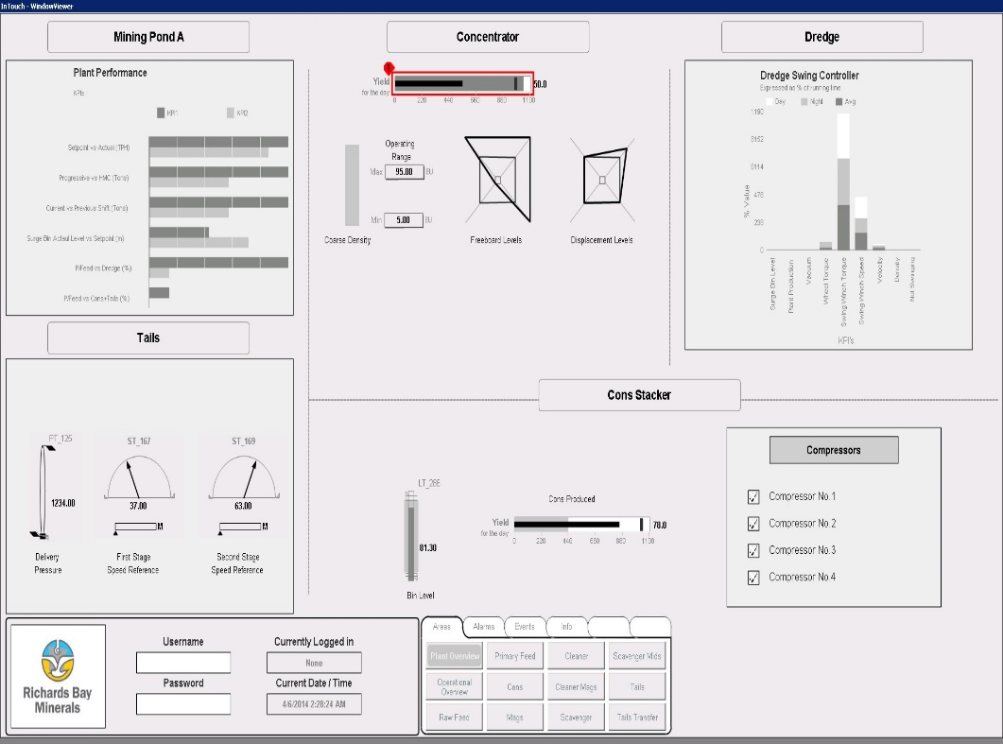
Situational Awareness

Slide 12
Situational Awareness Software Components
Process Graphics
  Symbol Library (1,000,000 Combinations)
  Symbol Wizards (User Modifiable)
  Element Styles (User Modifiable)
  Element Style Animation
  Alarm Borders (Driven by Data Model)
  Trend Pen (200+ per page)
  Points Animation
  Connection Points
  Numeric Formatting
Supervisory Control
  Object Model
  Alarm Aggregation
  Alarm Severities
  Alarm Shelving
  State Based Alarm Suppression
Historian
  High Speed Data Storage
  High Speed Data Retrieval
  High Speed Alarm Storage/Retrieval
  Historical Statistics Access
Wonderware Alarm Adviser

Slide 13
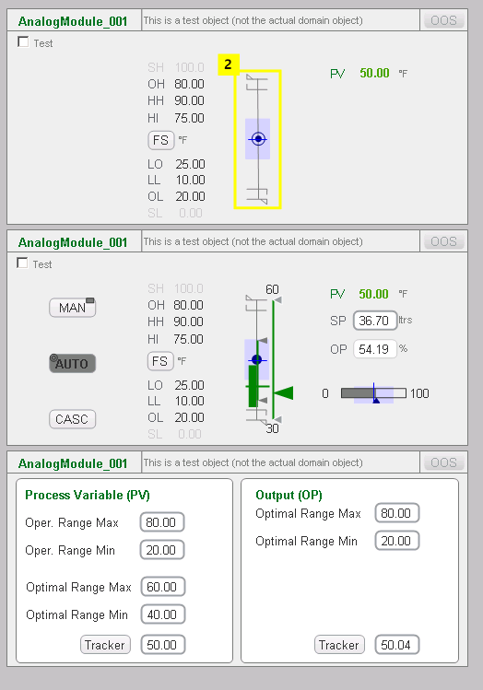
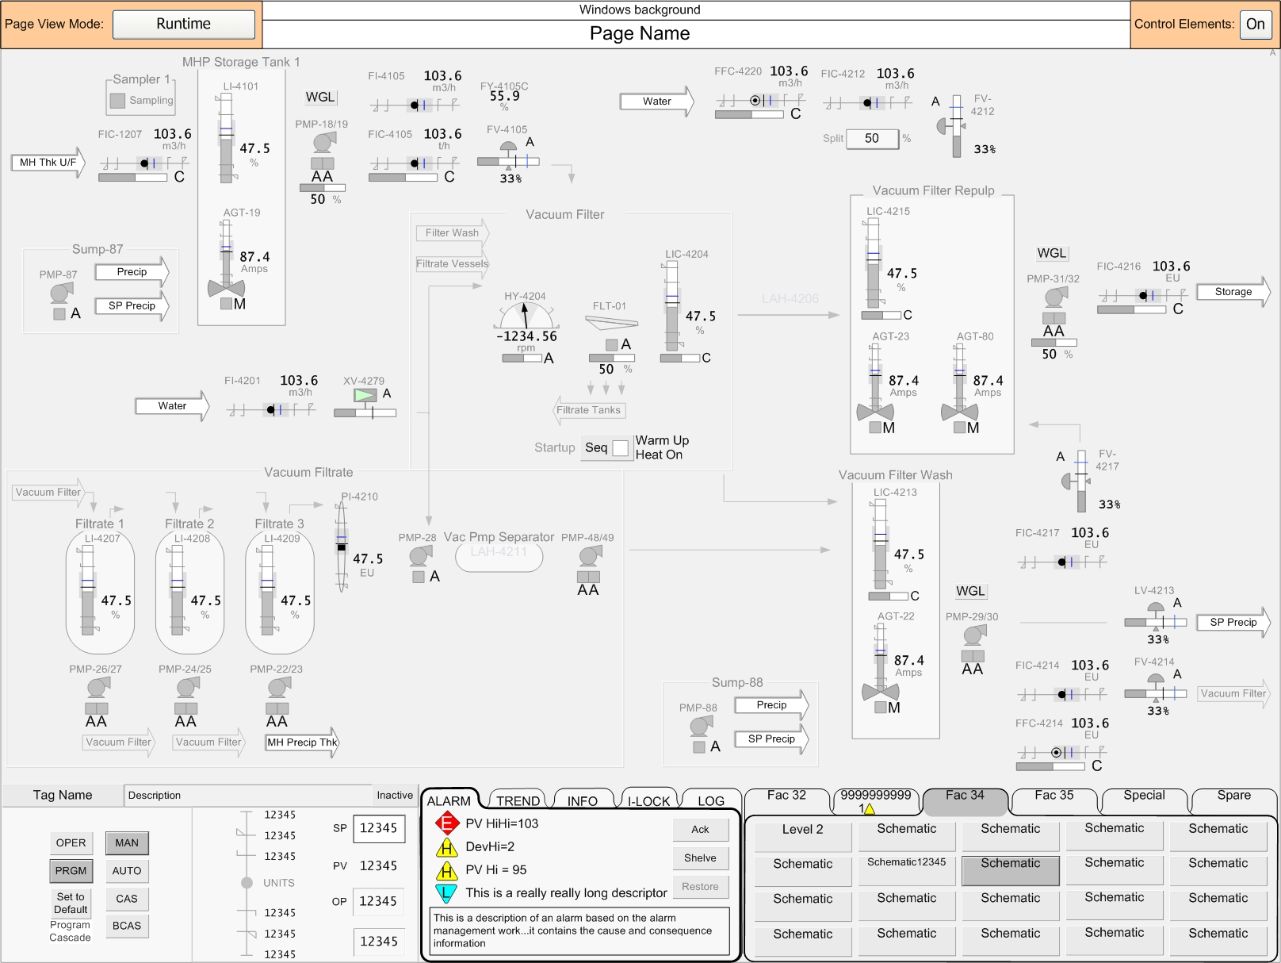
Expanded Situational Awareness Library
Symbol Wizards
Common Graphics
Object Wizards
Symbols
Faceplates
Application Framework
Layouts
Dashboard
Symbols
Faceplate
Dashboard

Slide 14
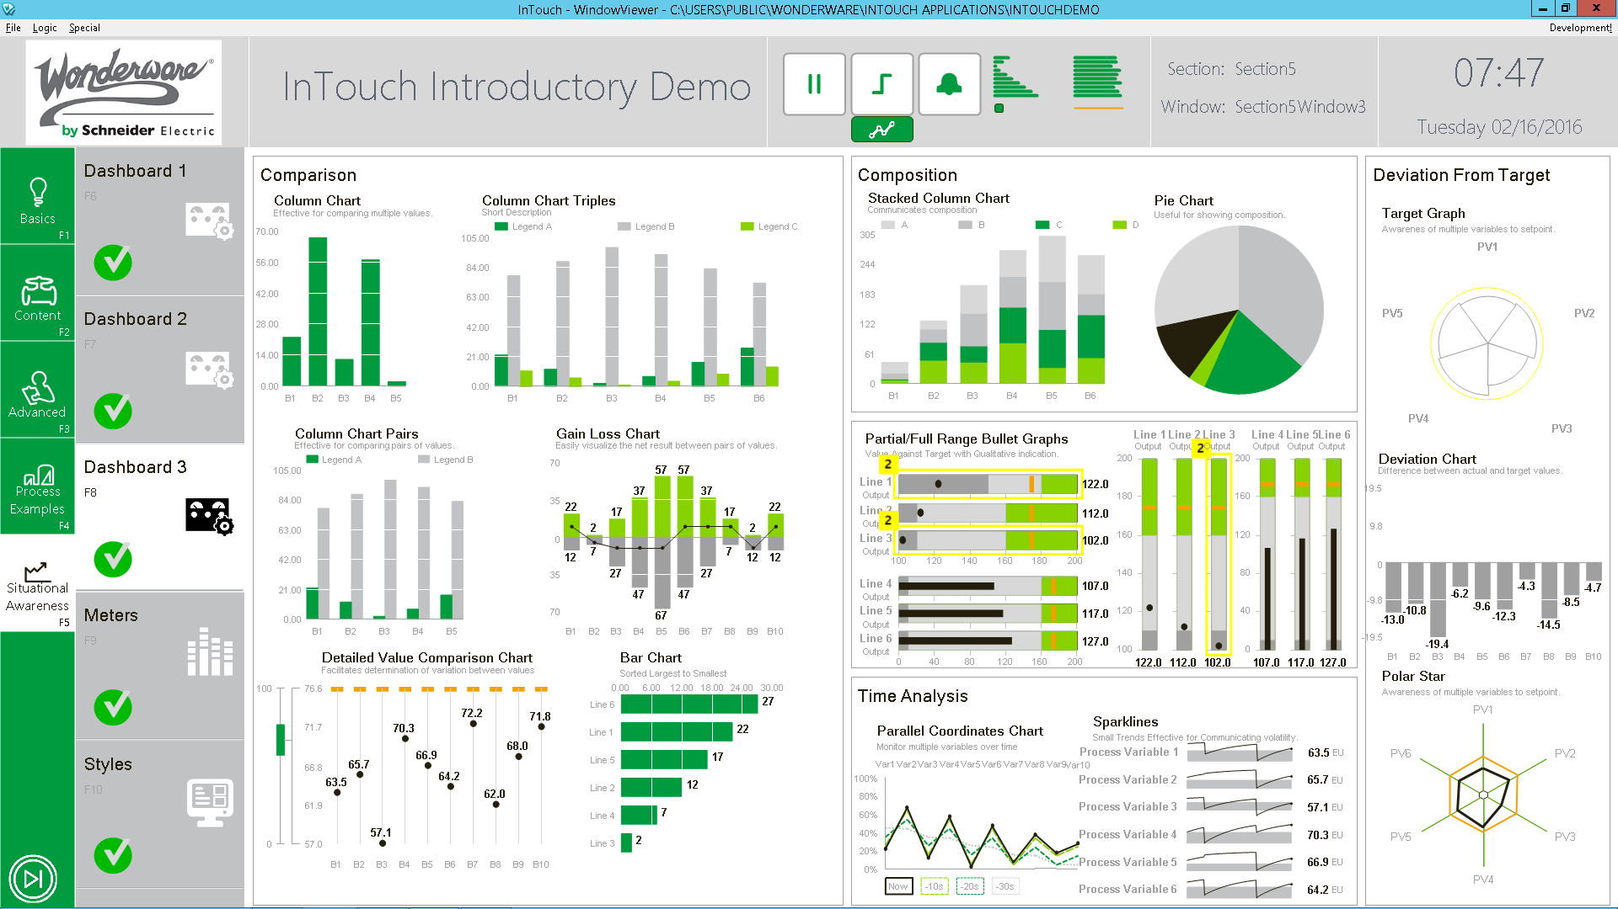
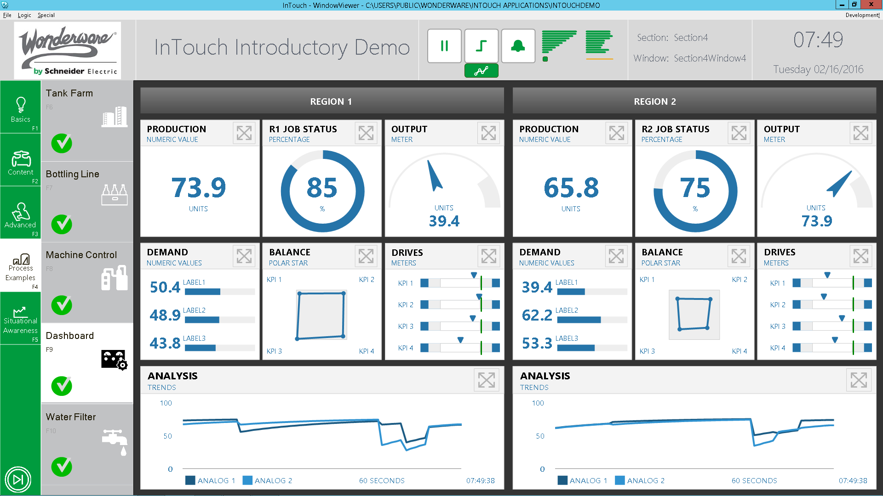
Situational Awareness - Continual Evolution

Slide 15
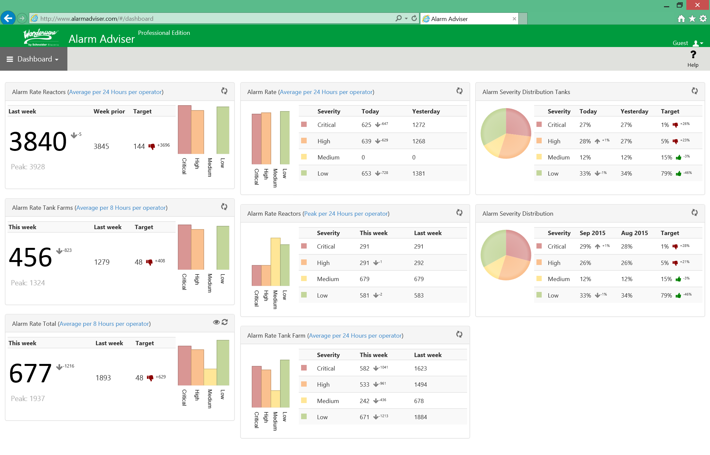
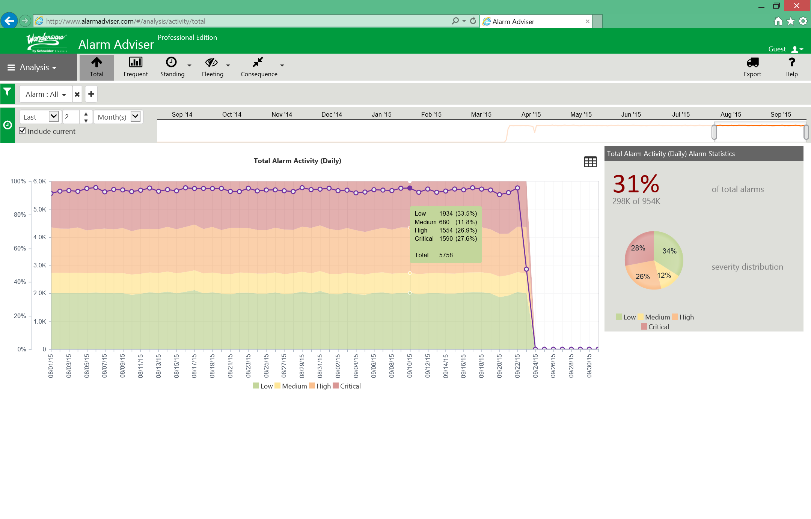
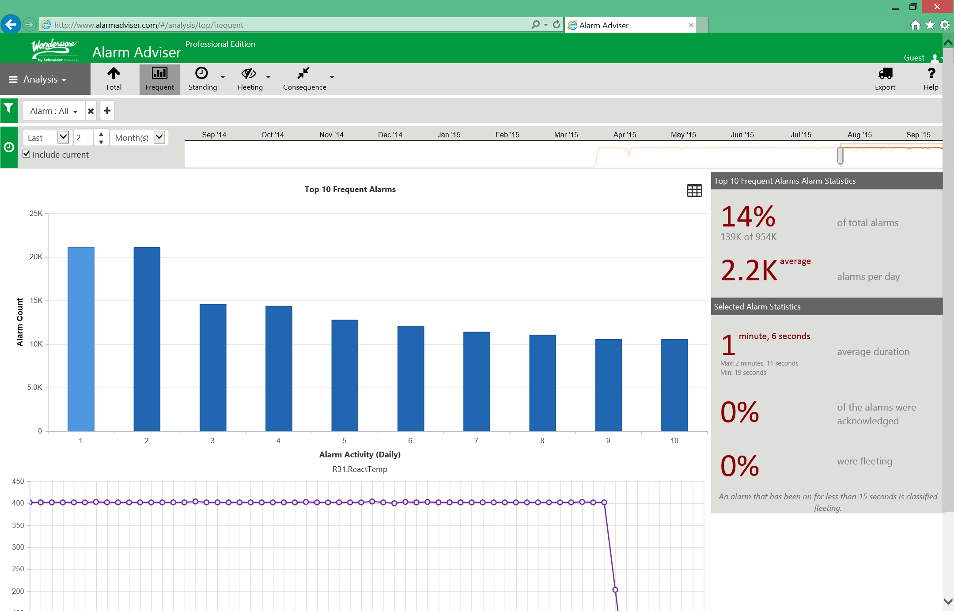
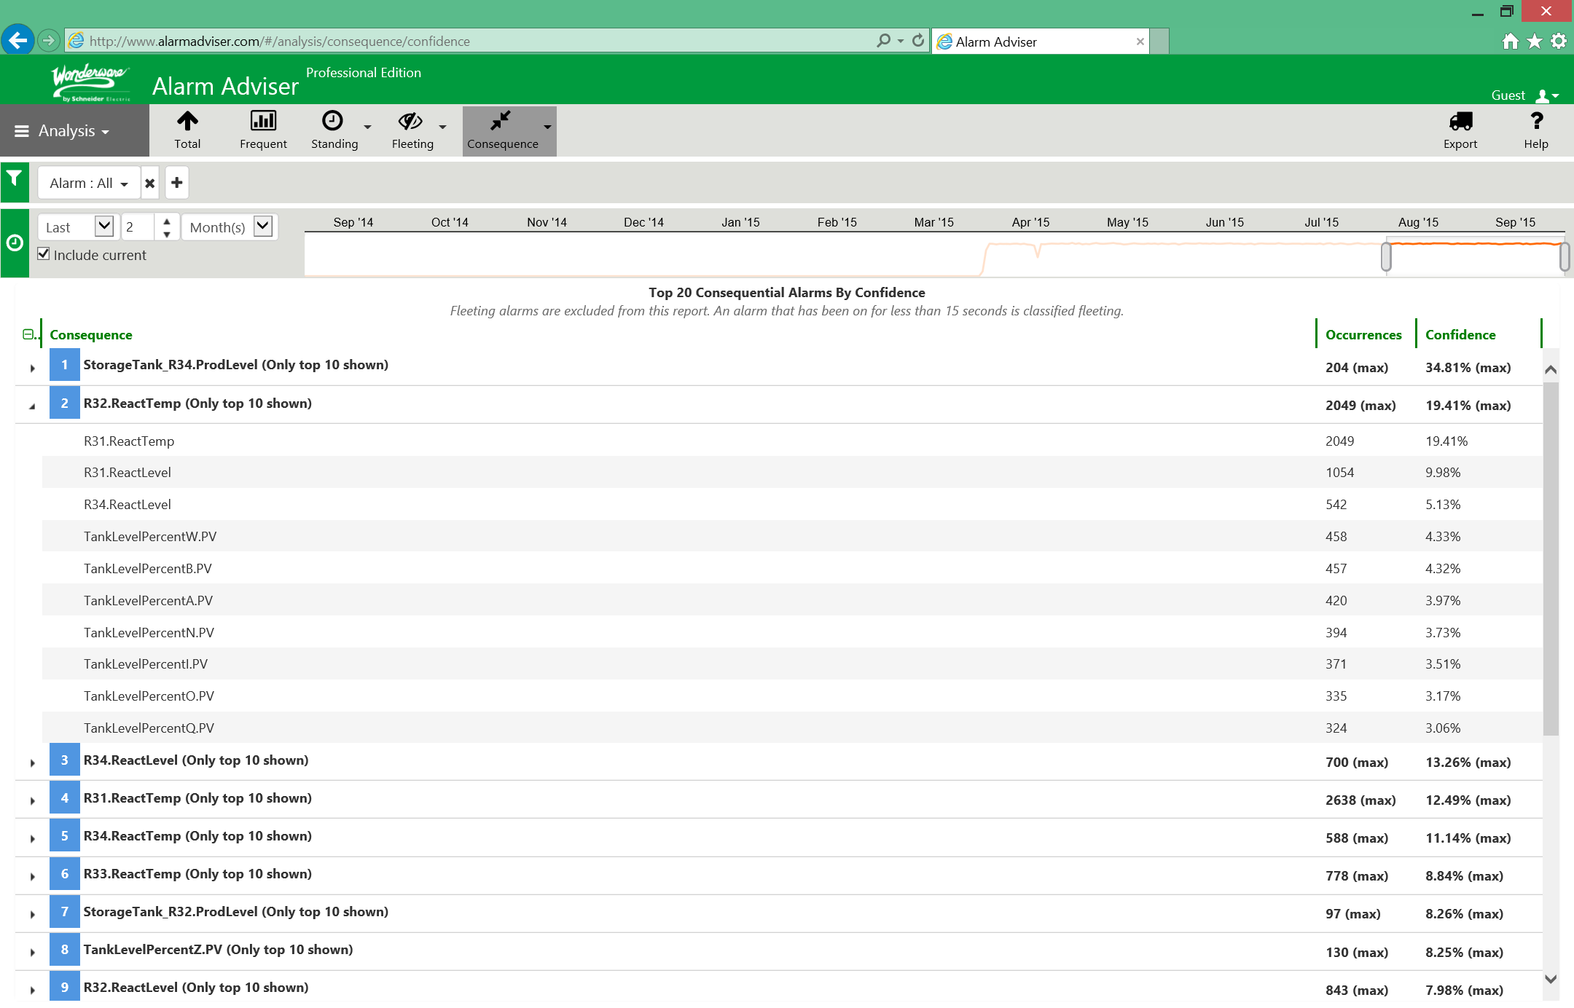
Wonderware Alarm Adviser

Slide 16
IT/OT Convergence

Slide 17
IT/OT Convergence
IT
OT
Purpose
Managing Information, Automate Business Processes
Managing Assets, Controlling Technology Processes
Location
Data Center, Cloud
Data Center, Local Device
Interfaces
Web Browser, Terminal and Keyboard
Sensors, Coded Displays, Web Browser
Ownership
CIO and Computer Grads, Finance, Procurement
Engineers, Technicians, LOB Managers
Connectivity
Corporate Network, IP Based
Control Networks (Serial, IP Based and Wireless)
Examples
ERP, SCM, CRM, Email, EAM, Billing
SCADA, PLCs, Modeling, Control Systems

Slide 18
Tools of Value to Operations Management
EMI
EAM
HMI
MES
ERP
Mapping/GIS
Historian
Downtime
CRM
Schematics
Alarm Mgmt.
PLC
SOPs
Chat
Vision Systems
Workflow
Reports
Manuals
Logbook
Energy Mgmt.
E-mail
3D Modeling
OEE
Quality
Inventory
Analysis
Simulation
Trends
IM/VOIP
MORE…
Batch
MORE…
IT
OT

Slide 19
Securing SCADA Systems

Slide 20
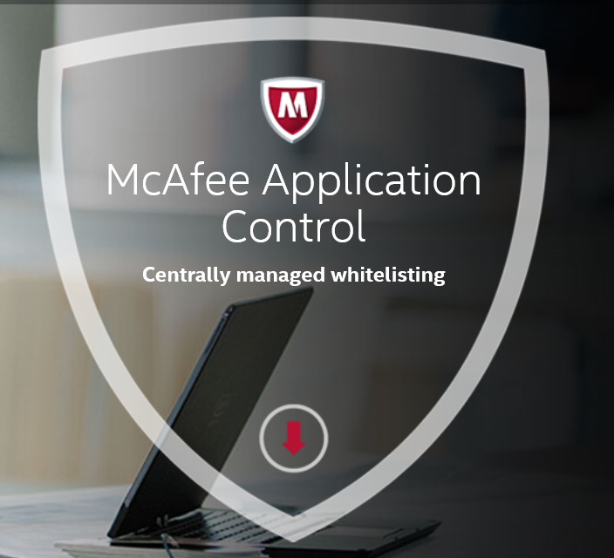
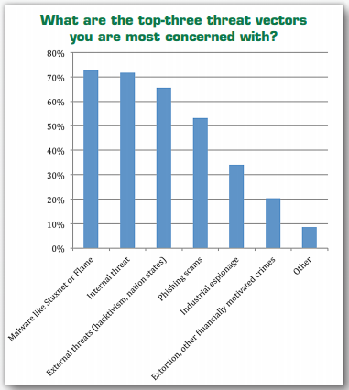
Securing SCADA Systems
Source: SANS Institute

Slide 21
Life Cycle Management

Slide 22

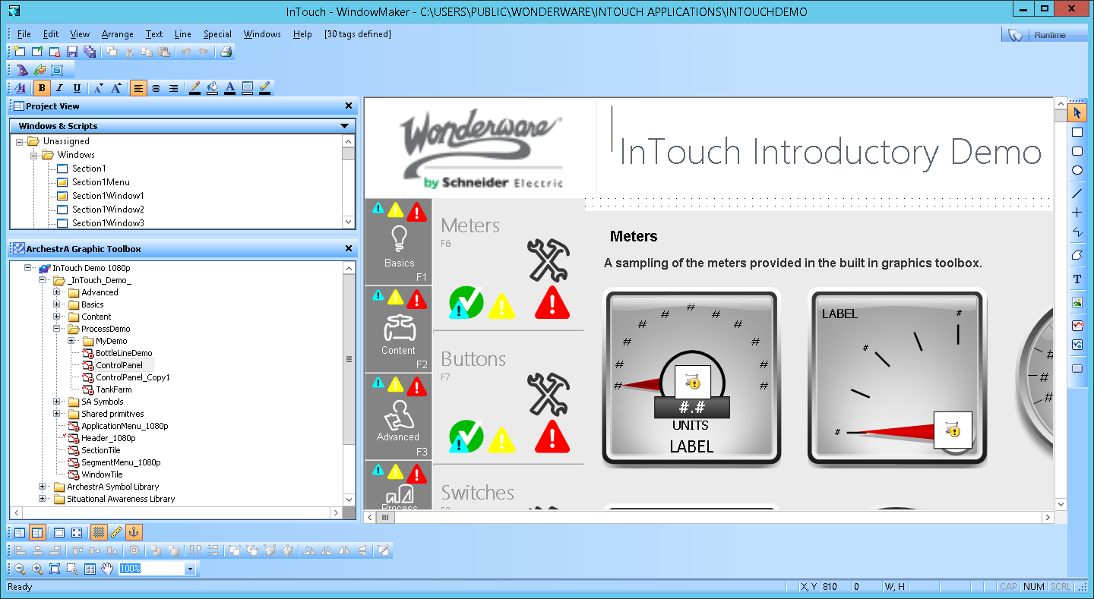
Ease of Use Commitment
InTouch Modern Application – ZERO IDE Workflow

Slide 23
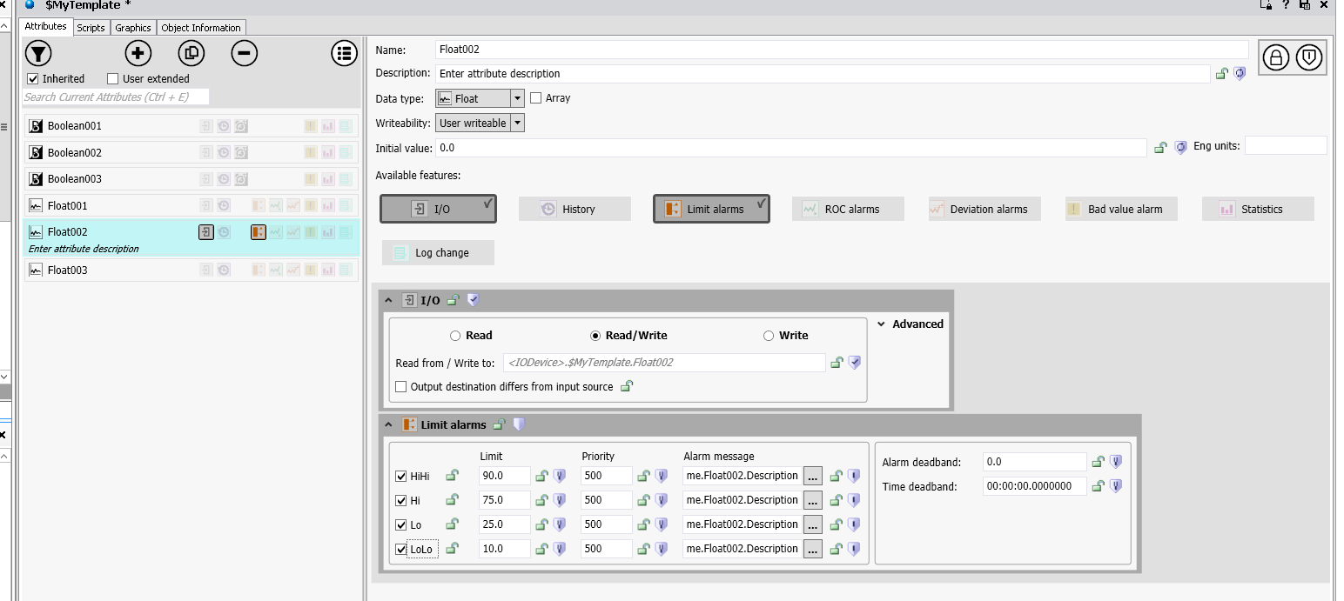
Ease of Use Commitment
ArchestrA Object Redesign

Slide 24




HMI/SCADA System Lifecycle
Define/
Improve
Design
Mission
Critical
Use
Build
Deploy
Test

Slide 25


Slide 26


Slide 27
Leveraging Information

Slide 28
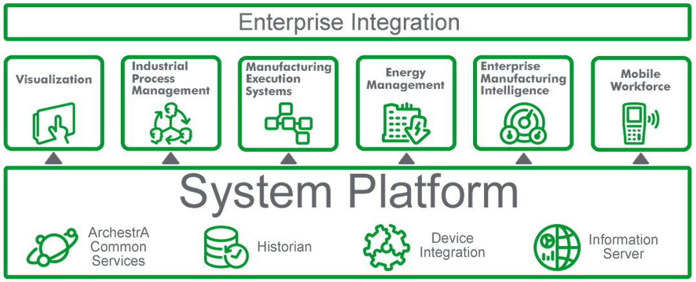
Real Time Business Management
The ONLY Platform for Industrial Automation!

Slide 29







Historian Architecture Flexibility
1. Wonderware Online
(no infrastructure)
2. Simple
On-Premise
3. Remote IDAS
(no local clients)
4. Local Edition
(local & central clients)
5. Redundant
(reliable access)
6. On-Premise
+ Online
Notes:
And we made it really simple to set up and use
Easy to integrate with other automation components
Made it cost-effective in industries that weren’t able to justify the investment before

Slide 30
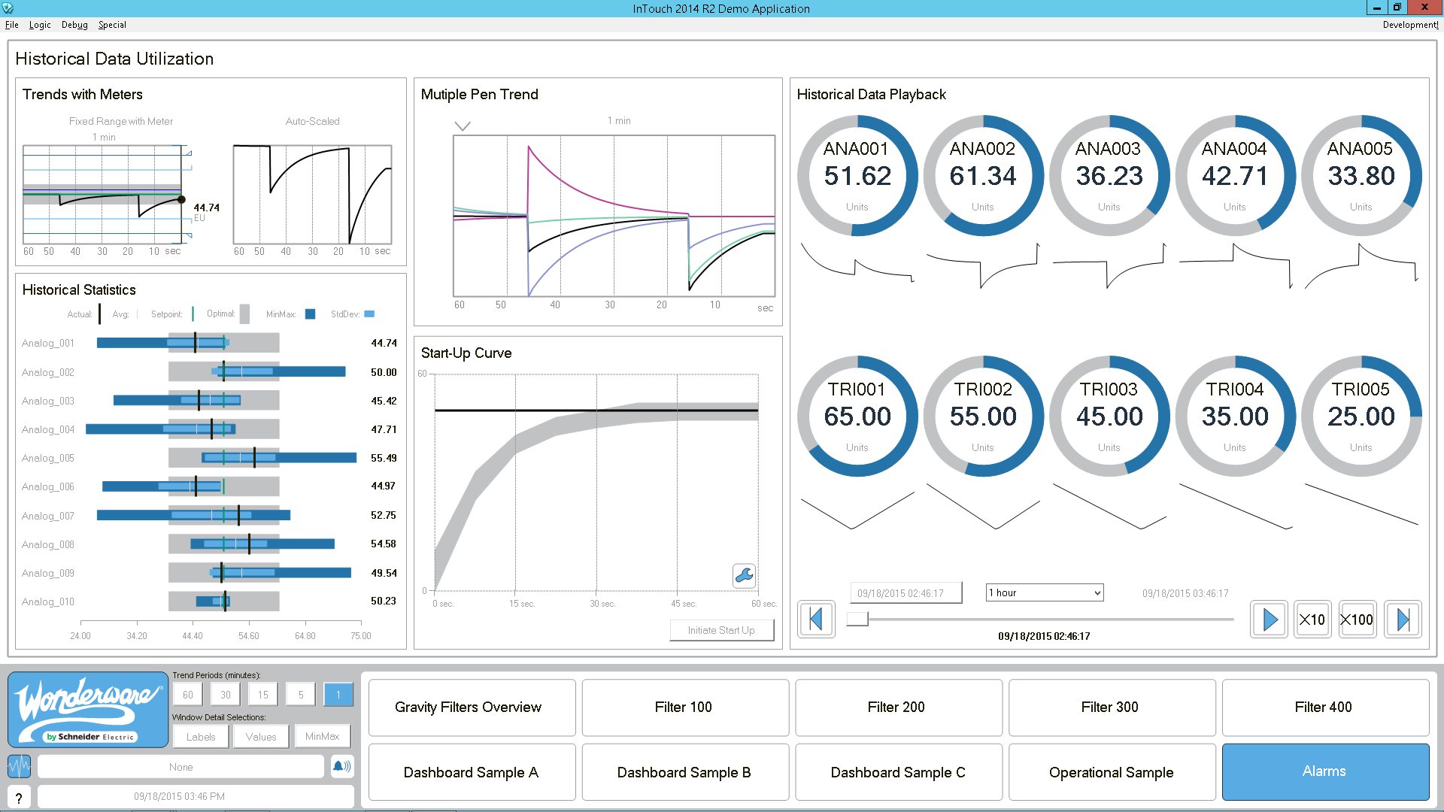
Leveraging Information
Combine Real Time Date and Historical
Provide Greater Insight
Enable Proactive Operations

Slide 31
Industrial Internet of Things

Slide 32

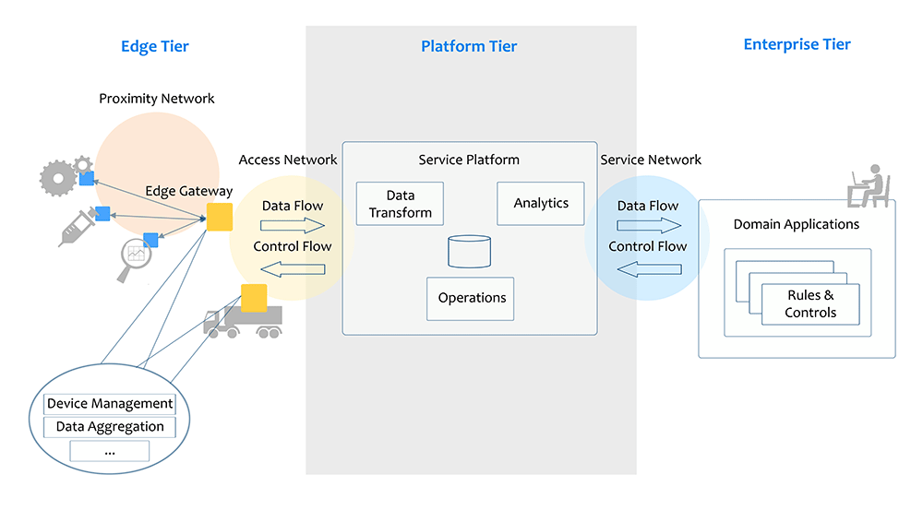
Industrial Internet of Things
Industrial Internet System Reference Architecture

Slide 33















New OI Servers?
FIRMWARE 28 UPDATE
Conversion of DAServer to OI Server
  OMRON
  ITME (InTouch Machine Edition)
New OI Servers
  Modbus Serial
  Texas Instruments
  DNP3
  ABB Totalflow
  CANopen
  Additional Automation Direct
  Additional Mitusibishi
Notes:
Our traditional offering supports the most popular platforms in the industrial supervisory market.
We want to ensure we expand our coverage.
Add additional drivers
Expand the offering of Wonderware suite of drivers to make our single source offering more competitive.

Slide 34

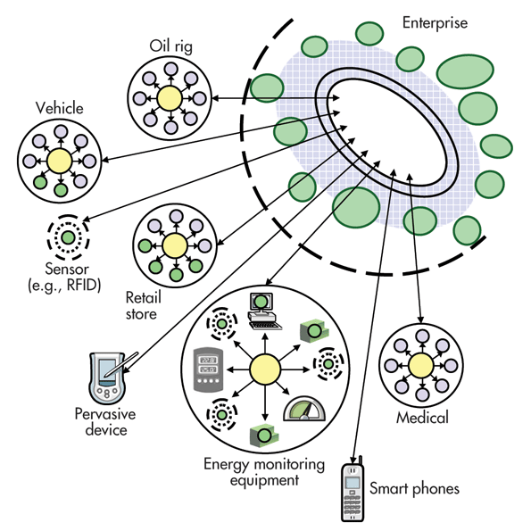
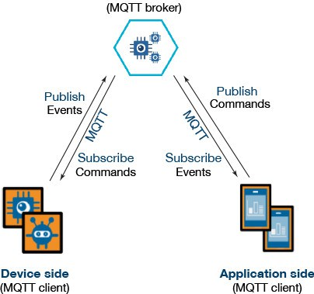
IOT Operations Integration Servers

Slide 35
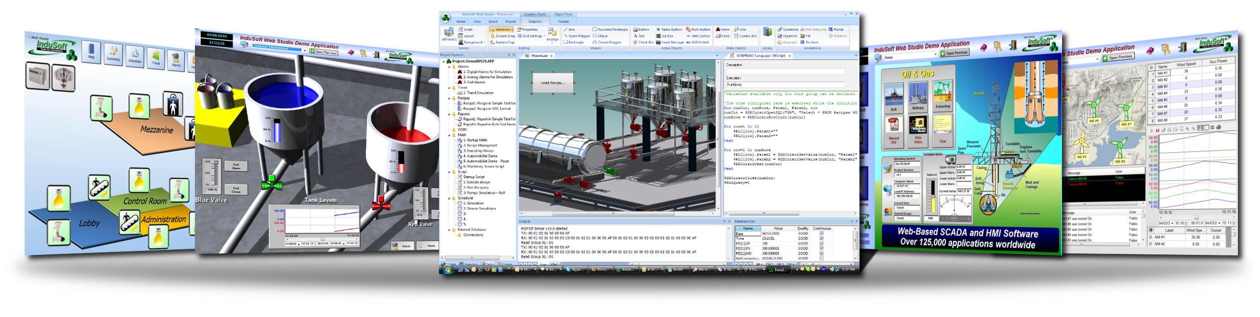



InTouch Machine Edition - IoTView
InTouch Machine Edition 2014 R2

Slide 36


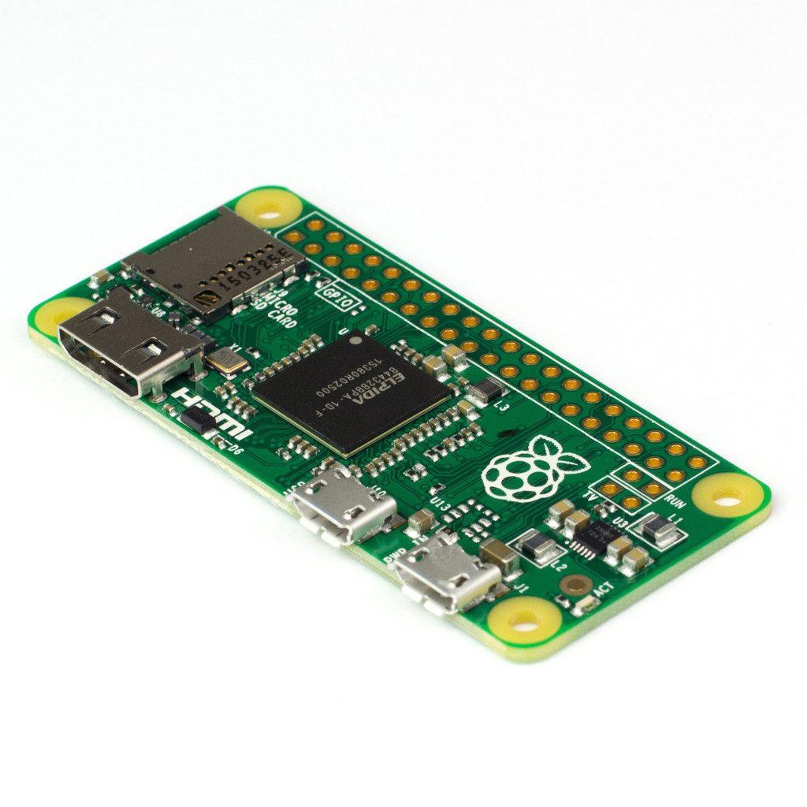




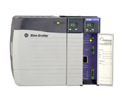
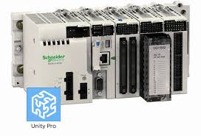
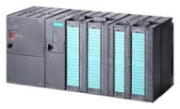
Expand Our Reach: Prometheus
Single source configuration tool
Single source environment enables the creation and management of corporate standards
Security, validation and download via vendor software:
- code can be viewed and modified using the vendor software
- real time connection monitors for safe deployment
- real time roll-back and version management
Schneider
Unity Pro
Siemens
SIMATIC Manager
Rockwell
Studio 5000
Wonderware
System Platform
Single source configuration seamlessly manages thousands of complex relationships between controllers, and controllers and supervisory applications in realtime. (Hybrid DCS)

Slide 37
Modernization

Slide 38
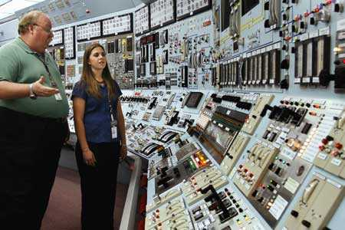
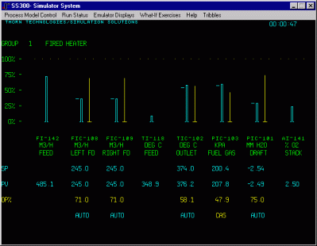
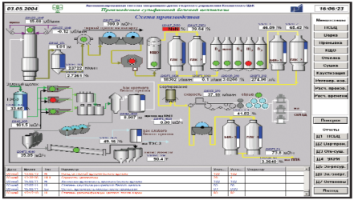
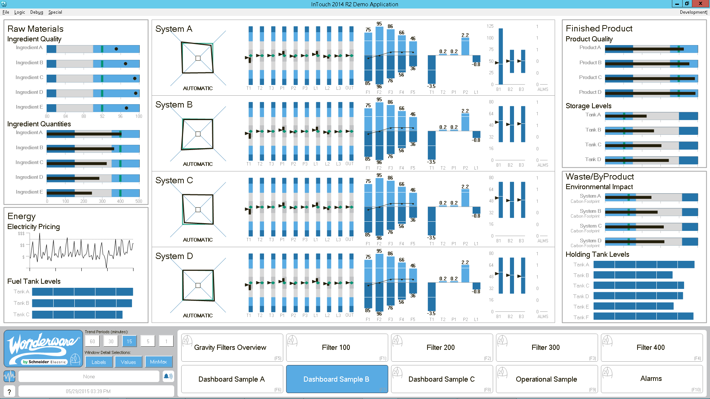
Modernization
HMI SCADA methods are constantly evolving…
1970’s
1980’s
2000’s
2010’s
Notes:
Software, UI , Hardware and Networks are constantly changing and we must adapt to these changes to get the most business value out of these systems.

Slide 39
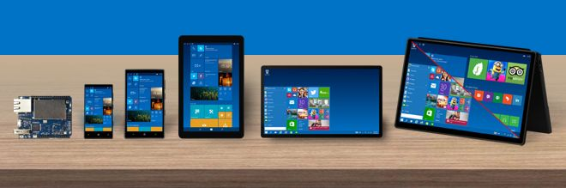





Keeping Current

Slide 40

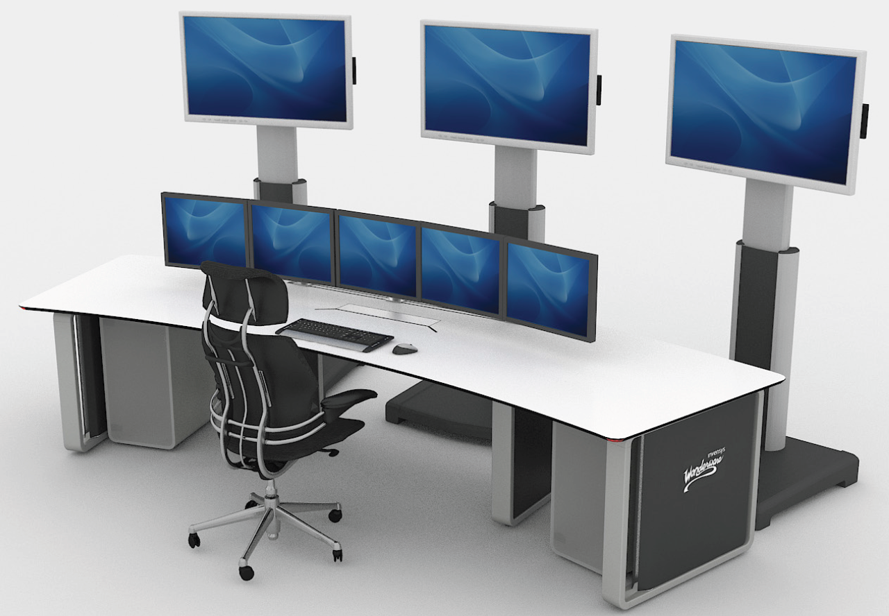
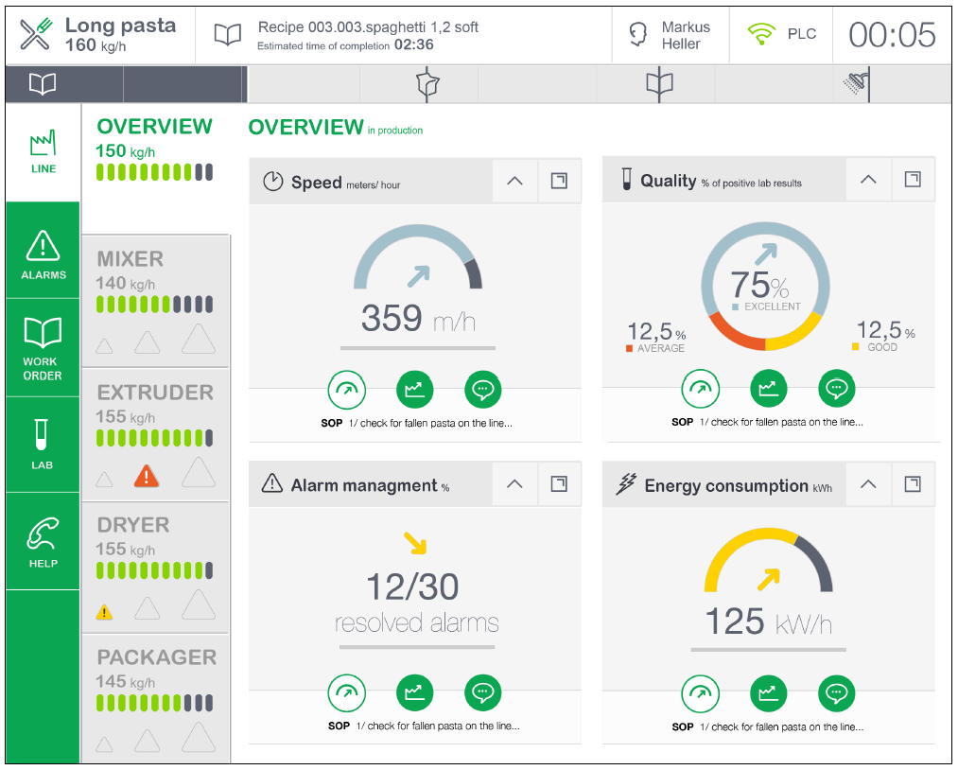


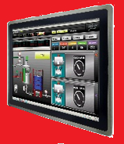
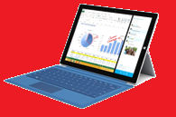
Contemporary User Interactions/Devices
Who?
What?
Where?

Slide 41

Sagittarius Video

Slide 42
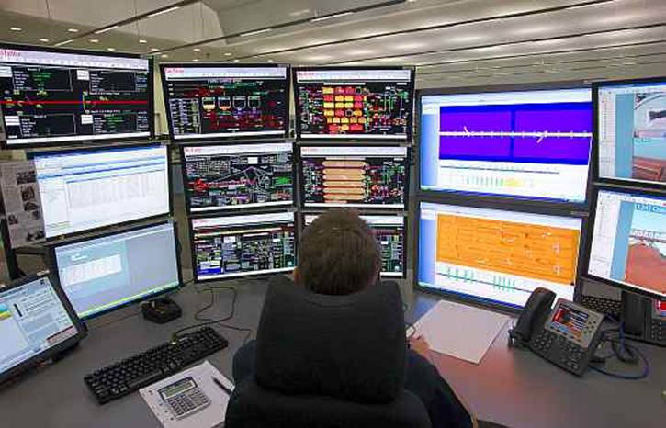
Various Systems Challenge

Slide 43
A new approach…
Manual
OIT
HMI
SCADA
OMI
Operations
Management
Interface

Slide 44
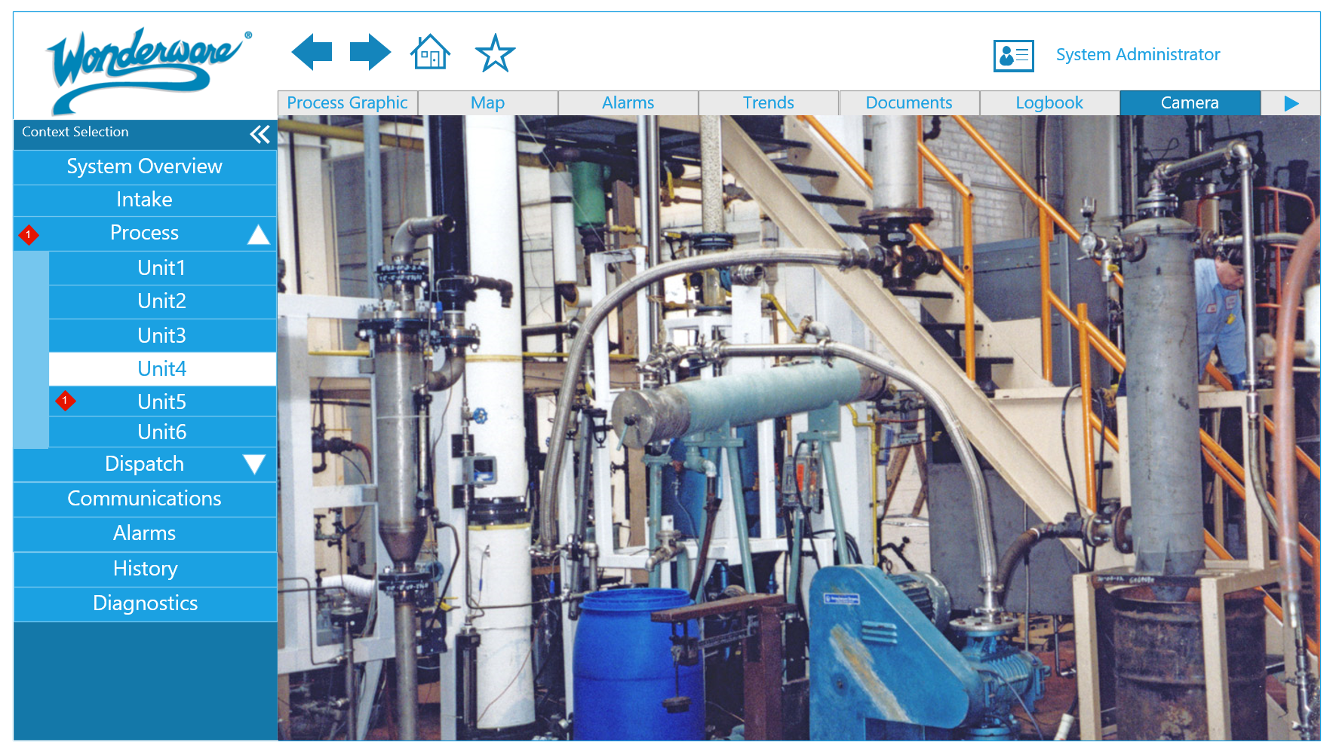
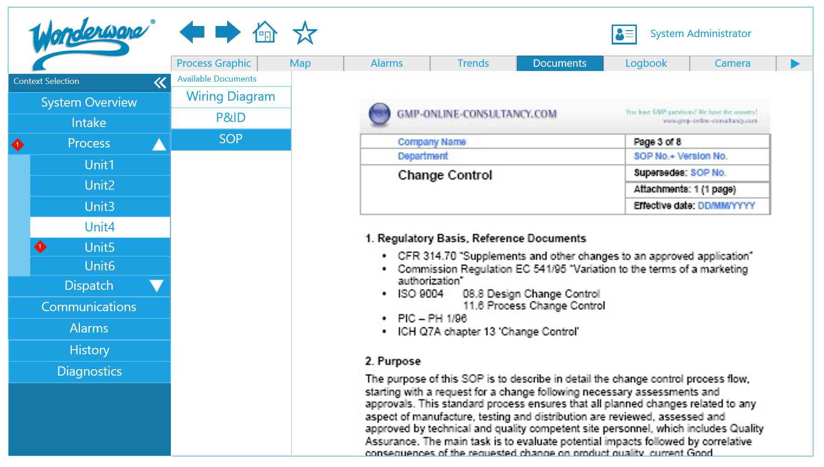
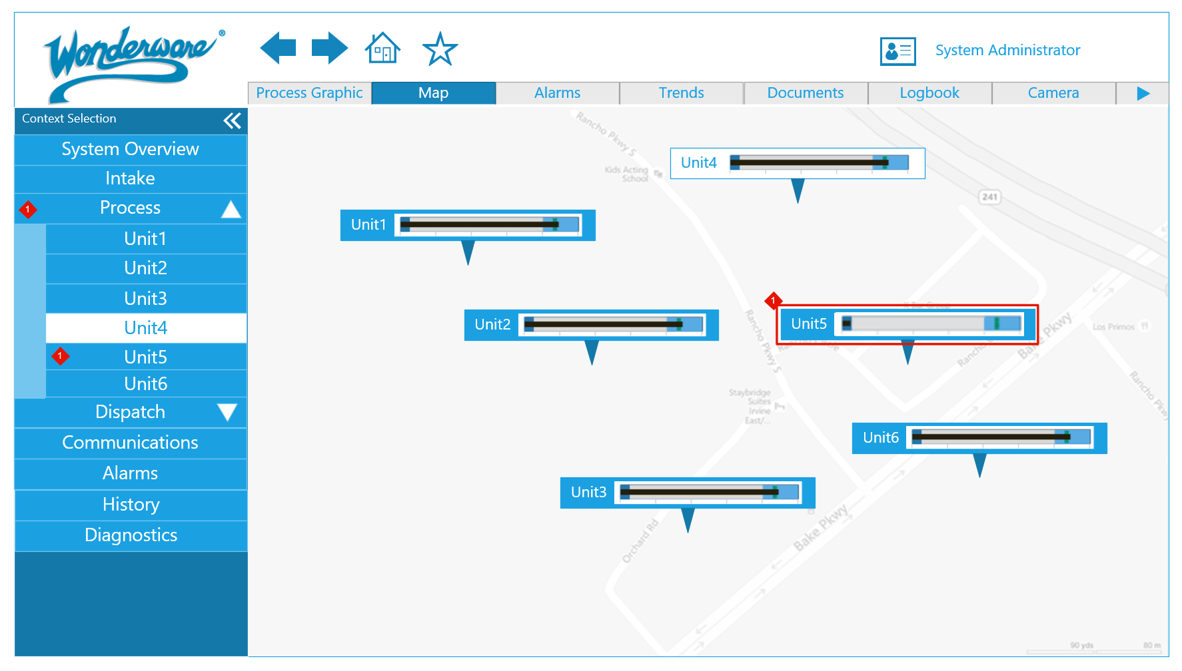
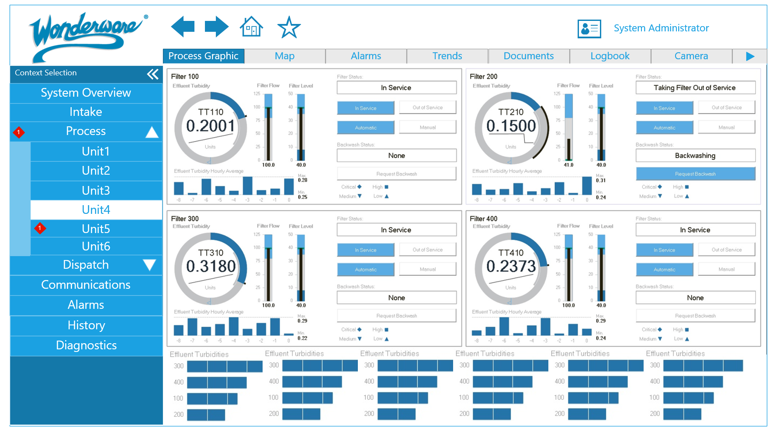
OMI Example

Slide 45
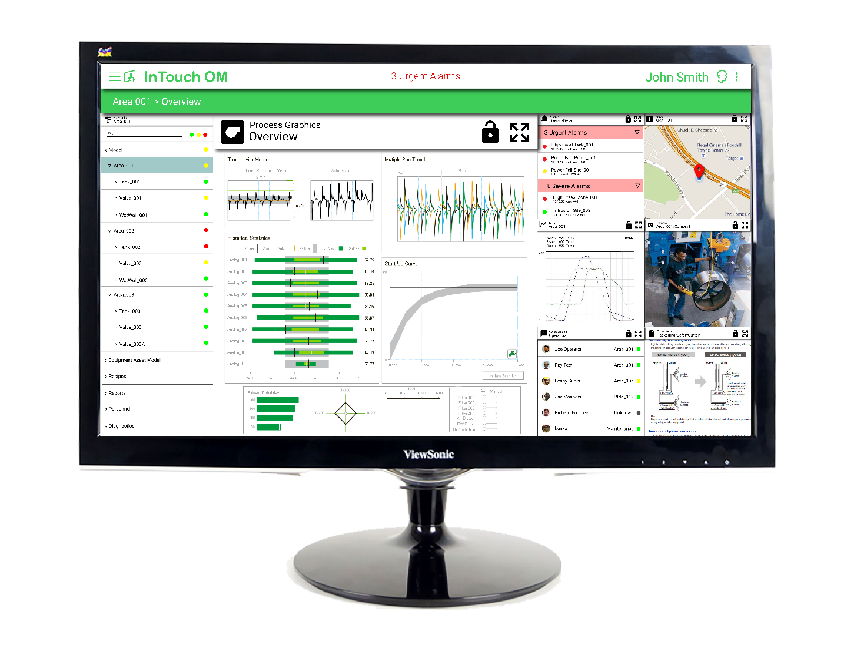
Desktop Experience

Slide 46
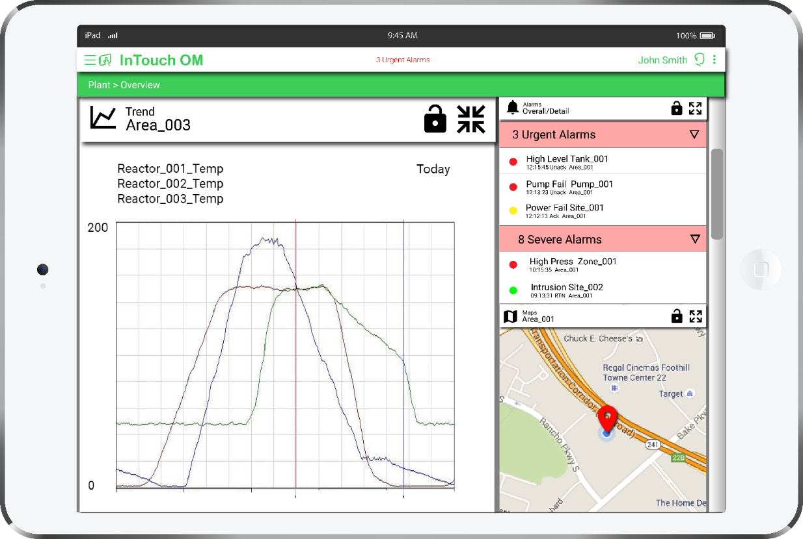
Tablet Experience

Slide 47
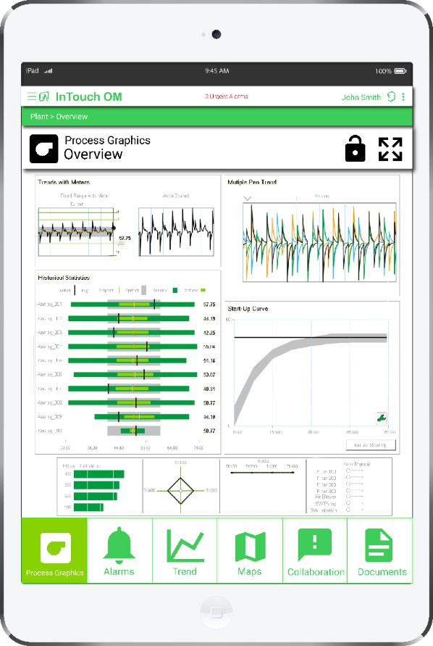
Tablet Experience Portrait

Slide 48

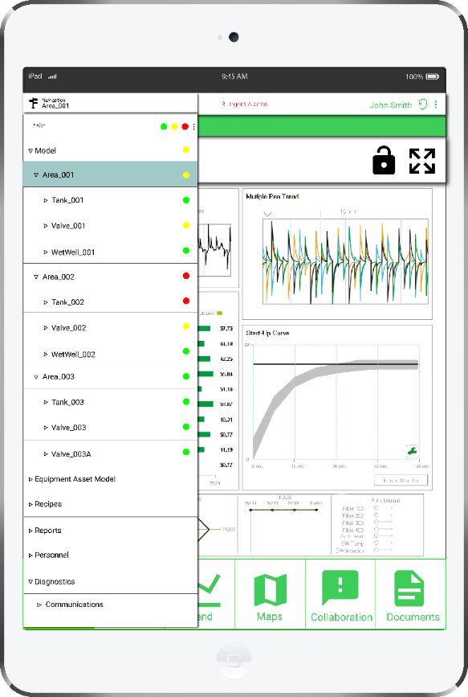
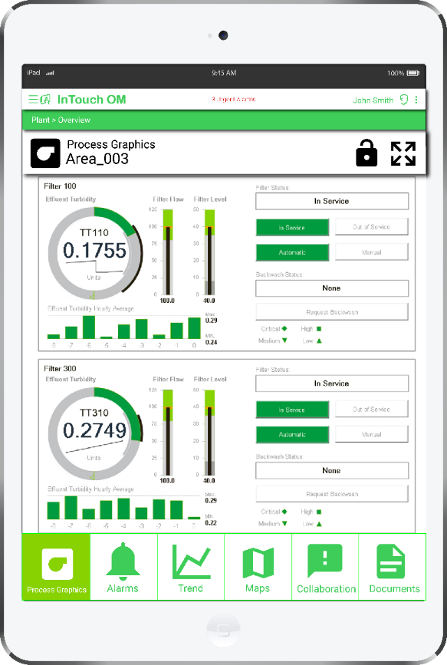
Context on a Tablet

Slide 49
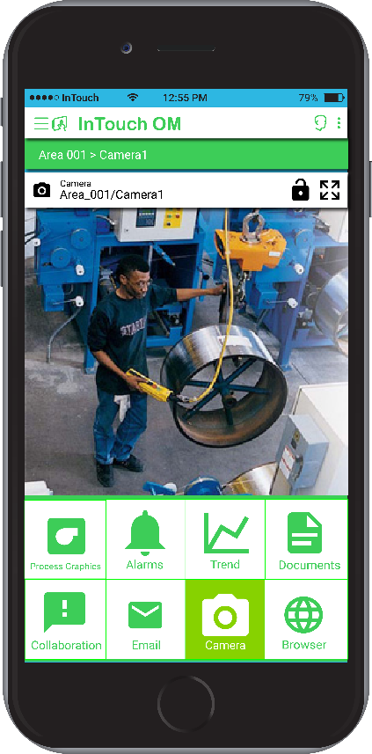
Phone Experience

Slide 50



Context on a Phone

Slide 51

Past
Future
Process Parameters
Situational Awareness
Labor Resources
Information Craftsmen
Reactive Operations
Proactive Operations
Operating a Process
Real Time Business Management

