Slide 1

The ABC’s of VFD’s
Larry Stanley
IWEA, Indianapolis, IN

Slide 2

The ABC’s of VFD’s
A very basic “look” at a Drive.
But, how does the VFD work?
Cost efficiencies….Why are Drives Used?
Different applications where drives are used
Expressed concerns or considerations
Fact! A real-life application case study

Slide 3
What is a Variable Frequency Drive?
Definition (VFD):
  A Variable Frequency Drive converts the incoming AC line voltage and frequency to a fixed DC voltage. The fixed DC voltage is then reconverted to a pulsating DC voltage. To the motor, the pulsating DC voltage looks like an AC voltage that varies in amplitude and frequency.
      -OR-
  Very simply stated, the variable frequency drive controls the motor so that it may be run at very low speeds, very high speeds or anywhere in between.

Slide 4
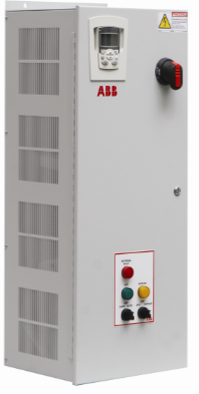
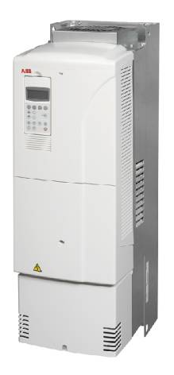
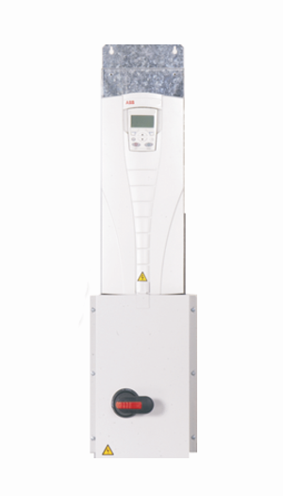
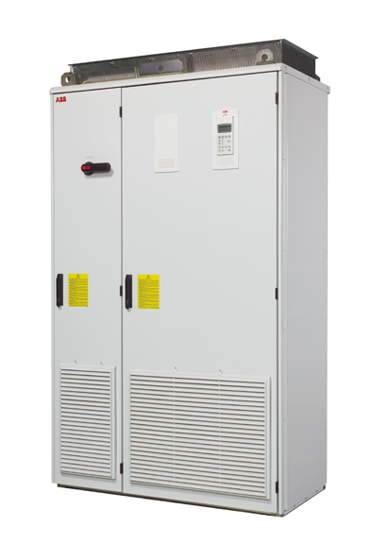
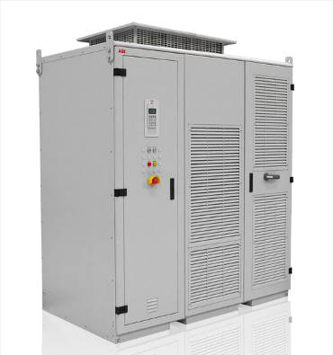
What does a drive look like?
Input Disconnect (PD) or Circuit Breaker Package (PC)
Classic 3 contactor bypass
N1, N12, N3R, N4x rated enclosures
Active filter, passive filter, 18Pulse, Active Front End
Notes:
Several packaged options are available for the ACQ550. A packaged version with a disconnect and fuses is one choice and a packaged version with circuit breaker is another. Both versions include the standard Advanced Control Panel, along with the embedded fieldbus communications capability previously mentioned. This package option allows the user to standardize on equipment style and reduce the required wiring and wall space. Within the packaged option, there are a variety of control interface possibilities, including speed pot, Start/Stop pushbuttons and pilot lights.

Slide 5
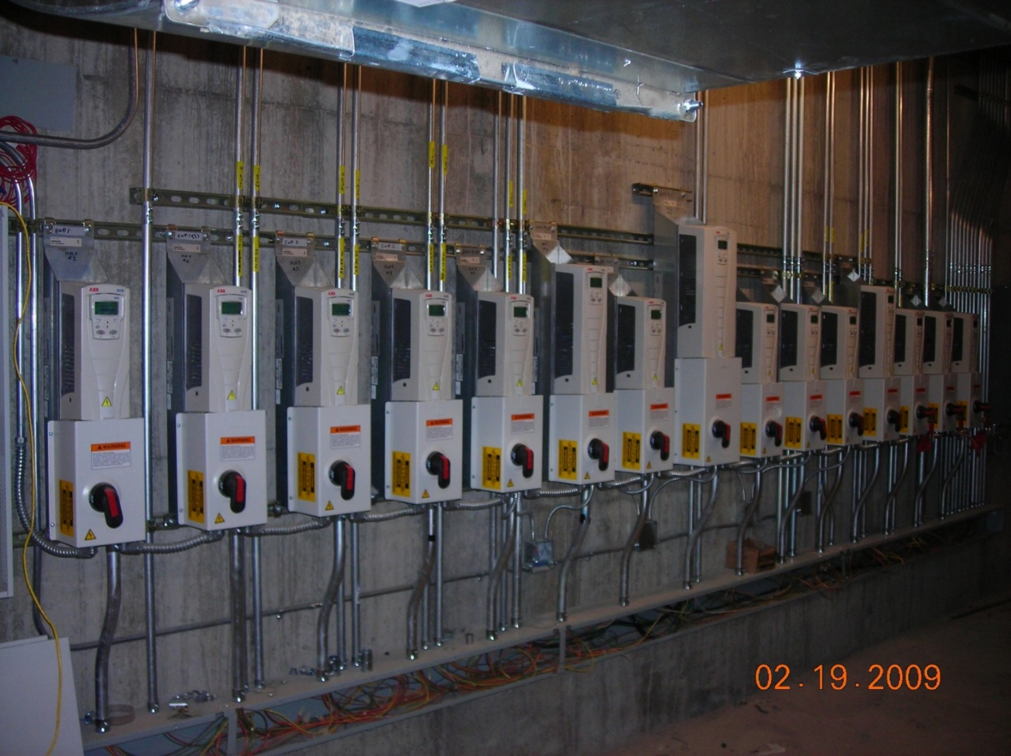
What do they look like installed?

Slide 6
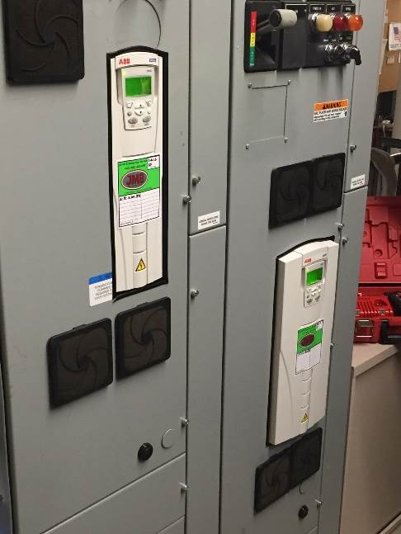
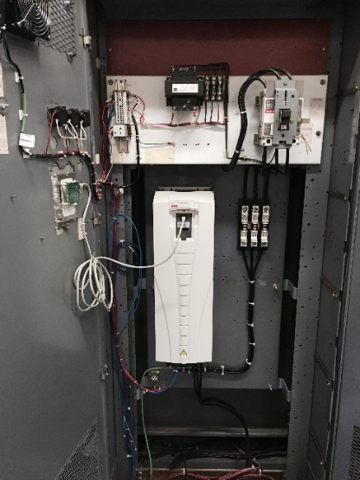
Maybe in MCC’s
Required for some applications due to space limitations
Higher initial cost
Replacement cost / compatibility

Slide 7
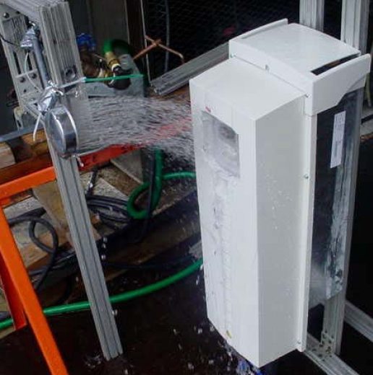
And sometimes they might get splashed!
Ambient Temperature
UL rated
  UL Type 1 dry, clean indoor
  UL Type 12 dirty, dripping water
  UL Type 3R outdoor
  UL Type 4 hose down
NEMA ratings are self certifying
  UL has very specific requirements

Slide 8
Let’s look at how it works.
Basic Construction
Diode Bridge
IGBT’s
L
+ dc
+
+
+
L1
C
Motor
L2
L3
- dc
_
_
_
DC Bus
+
+
_
_
Notes:
This figure conceptualizes how the three fundamental sections of an AC drive function together to convert fixed frequency, fixed voltage input power into variable frequency, variable voltage output power.
(click)
First, fixed frequency, fixed voltage three phase power is applied to the drive input diode bridge. The diode bridge converts this AC voltage input into a DC voltage which has relatively high ripple content.
(click)
Next, the DC link section filters the DC voltage modifying it into a smooth DC bus source.
(click)
Finally, the output IGBT section converts the smooth DC into variable frequency, variable voltage, 3 phase output power. This is achieved via intelligent pulse width modulation, or PWM control, that is further described on subsequent slides.

Slide 9
Creating a PWM Output
+
Positive
DC Bus
-
Negative
DC Bus
Converter
Inverter
Notes:
How this all works is much easier to understand if it is demonstrated.
(click)
Initially pulse on time is relatively short and pulse off time is relatively long. Based on a time average, this results in an effectively low voltage. Each successive pulse is given a slightly larger on time versus off time. Thus, the effective voltage increases with each succeeding pulse. This pattern continues until the pulse that corresponds to the peak of the desired sine wave occurs.
(click)
At this point the pattern reverses and on time versus off time decreases with each succeeding pulse.
(click)
If the effective voltage versus time of the pulse train is superimposed on top of the pulse train, it can be easily seen that the positive portion of a sinusoidal waveshape is thus generated.

Slide 10
Creating a PWM Output
+
Positive
DC Bus
-
Negative
DC Bus
Converter
Inverter
Notes:
The same pattern can be repeated using pulse width modulation and the lower switch position to connect to the negative DC bus. This generates the negative portion of the sinusoidal wave shape. Thus, using the upper and lower switches, a sinusoidal waveshape with both variable magnitude and variable frequency can be generated. This is precisely the basic controlled waveshape needed to power an induction motor over a wide speed range.

Slide 11
Why Are Drives Used?
ENERGY SAVINGS - I’ll show you how!
Soft start – Controlled acceleration and deceleration
      Greatly reduces inrush current
      Eliminates mechanical shock & stress to equipment
      Extends mechanical life of equipment
Automation of Control and Protection
      Flow, Pressure or Level control
      Simple on board protection for pump jam, thrust bearing, etc..
Improved power factor
Reduced demand charge

Slide 12
What about functionality?
Capabilities of VFDs
PID control
  Sleep and boost?
Single Phase Conversion
Pump Alternation
ANTI-JAM pump protection
Thrust bearing protection
Critical frequency avoidance
Flying start
Electronic overload
Output Relay
  Programmable to timing relays
Analog Outputs
  0-10 Vdc or 4-20 mA
Supervisory functions
  Drive and System
Auto Restart
Bypass capability

Slide 13
An Affinity for Energy Savings
Variable Torque
Flow varies linearly
with speed
Torque requirement varies
as the square of speed
Power requirement varies as the cube of speed
Notes:
Discuss Affinity Laws here – briefly –
Motor Speed = 120 x Applied Frequency/ Number of motor poles. This makes it pretty easy to see that the only thing we have control over is the applied frequency. 120 is a constant and the number of poles is the motor is fixed. Think ---it’s a Variable Frequency Drive it is not a Variable Speed Drive – variable speed could be imply mechanical means like pulleys and sheaves – old Reeves drives and such.

Slide 14
Saving Energy by Changing Speeds
Power versus Speed - Variable Torque Load
100
75
Power is Proportional to (Speed)³
50
Power (%HP) (%kW)
42.1
25
25
50
75
100
Speed (%RPM), Flow (%GPM or %CFM)
Notes:
Very pertinent in this industry. 75% give a good point where flow may very well take place. When set to low, the pump may not be able to overcome the static head – running at low frequency such as 50% or below may very well not provide the required head and no flow will happen.

Slide 15
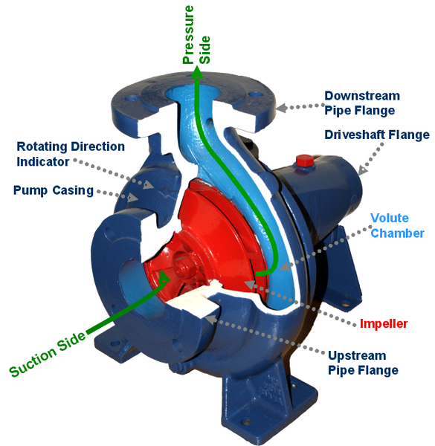
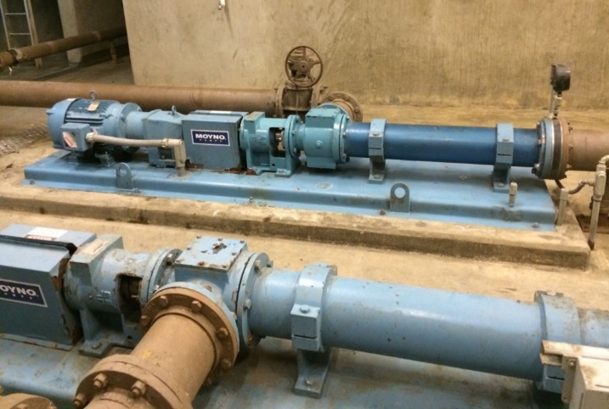
Where do we use VFDs?
Water Application
There are two basic load types:
  Variable Torque (VT)
    Centrifugal Pumps
  Constant Torque (CT)
    Positive Displacement Pumps
    Vacuum Pump
    Moyno Pump

Slide 16
Installation Considerations
Environment
What’s the environment?
  Fresh Water – Chlorine
  Waste Water – Hydrogen Sulphide
Important considerations are:
  Temperature.
  Altitude.
  Indoor/outdoor - exposure moisture and sunlight.
  Space requirements.
VFD manufacturers provide a variety of enclosures that are certified to UL standards
Notes:
Solution may contain more than the drive. Be sure to know the rating of the phase shifting transformer if a multi-pulse or any filter used for harmonics or long motor leads – especially concerning altitude
In door – it’s not common – but think about drives in front of large windows
Its good to know East and West – anything to provide some shading for 3R products?
Space is always a premium. Make sure products can be mounted back to back or side y side- think about doors swinging open –will they hit anything. Electrical inspectors don’t have to be forgiving and most often are not. It’s for our protection!

Slide 17
Installation Considerations
Temperature and Altitude
VFDs are rated for a specific ambient temperature
  Typical temperature range is -10°C to 40°C (104°F).
  Typical altitude is 1000 meters.
  The VFD must have the ability to dissipate heat generated during the power conversion process.
  If actual values exceed the VFD manufacturer’s assumptions, the drive may have to be de-rated. Consult the manufacturer.
Notes:
Some drives can be derated to as much as 60 degree C – that’s hot – and one must consider the longevity of the product when installed in this type of environment
LRS Note – I don’t work well above 104 and neither does electronics…. Not for long, it’s heat stroke

Slide 18
Installation Considerations
Space Requirements
VFDs may have a restriction on space between adjacent equipment or machinery.
The issue may relate to heating from adjacent heat sources or more likely the possible restriction of air flow which is required by the VFD cooling system.

Slide 19
What about the wiring and maybe a new motor?
Motor Leads (Discuss this with your manufacturer)
  Shorter is better, metallic conduits, VFD rated cable
  NEVER EVER run control wiring on line leads with motor leads
Grounding
  Ground each VFD individually – do not daisy chain or loop
  Motor ground should be terminated on VFD ground – not back pan
Motor
  MG1, Part 31 – covers the windings
  Shaft grounding device for common mode voltage
  Use invertor cable or pull high strand count ground wire

Slide 20

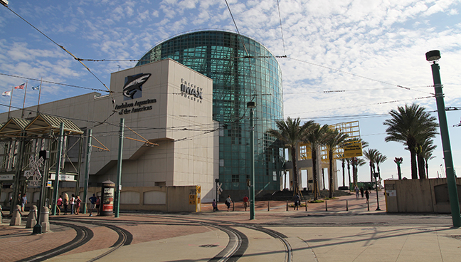
Case Study
Audubon Aquarium of the Americas
Notes:
First introduced to the Aquariums and Zoos through AALSO – Aquatic Animal Life Support Organization
Displayed the pump efficiency demo in - Well over 100 LSO (Life Support Operators) and Asc. Stopped to review the drives, pumps and motors
Many Aquariums and Zoos are operating on the original installed equipment – using FVNR and Flow control valves
There are over 250 Aquariums in the US

Slide 21
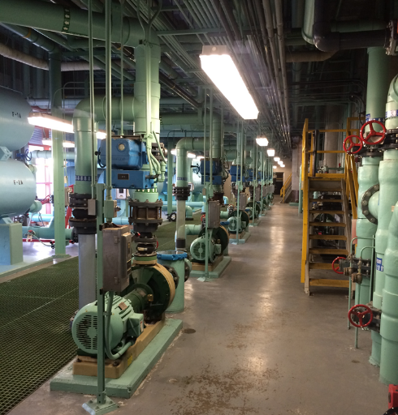
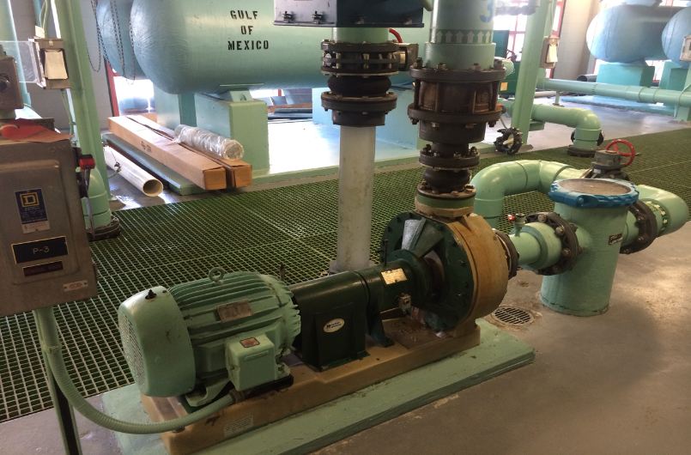
How It All Flows
Pump Alley
  7 - 25HP pumps
  14 Sand filters
  Gulf contact and degas towers
  Ozone generators
  Wastewater recovery system
  Storage water
Notes:
Pump alley contains all the motors and pumps for the sand filters for this Aquarium.
There are 7 – 25 Hp, 460 Vac, centrifugal pumps and all 7 were limited to about 45% flow
City Sub-Station sat adjacent to the Aquarium. The available fault current was high. Used ACQ550 for impedance – otherwise could have used ACS310

Slide 22
Concerns
Mechanical stress – especially during startup
Energy costs
Available rebates
Maintaining correct head pressure with flow reduction
VFD control method
Start-up and commissioning
Notes:
They were looking for some way to reduce the mechanical impact of starting the pumps cross the line. There is one picture in here showing mechanical damage to one of the flexible couplings.
The Aquarium Administration Staff was not familiar with using VFD’s or energy savings from them
Was unsure how to get the rebates
Local support was critical. Setting the drives up to operate correctly was imperative. The filters at this location had flow sensor that provided a 4-20 mA signal to indicate the flow through the filter – but it had never been utilized – only the display had been used to mechanically set the flow restriction valve. The local ABB distributor had the staff to install and commission as required.

Slide 23
Economic Justification
Energy Cost
  Audubon buys energy at .08 / KWH
Pump Qualifications
  Originally controlled via a flow restriction valve
  Flow typically between 40 and 100 %
  Average flow under 50%
Payback calculation
  Calculations set motor speed between 70% and 100%
  Payback expectation of UNDER 6 months
  51 additional pump applications
Notes:
The first calculations yielded about a 8 month payback. When the rebate people got involved, saw how the system was setup and requirements – they calculated the payback at under 4 months.

Slide 24
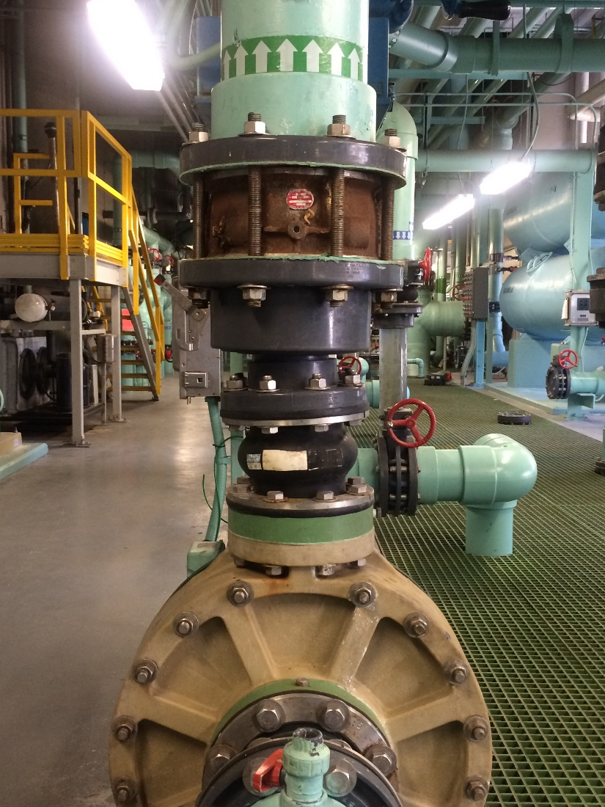
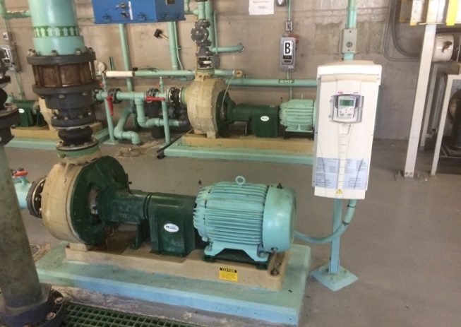
Economic Justification
Audubon Aquarium of the Americas
Value
  Local Support
  Energy Savings
  Automated Control (PID)
  Mechanical stress reduction
  Total payback
  Reliability
  Warranty
Notes:
Notice the picture on the right side. Noticed how out of line the rubber “dampner’ is to the pump and pipe system. There was a major concern every time they had to start this pump
Notice all the labeling on the front of the drive – bottom picture. The local distributor makes labels and attaches all the set up information pertinent to every drive .

Slide 25
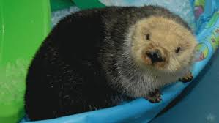
Economic Justification
Audubon Aquarium of the Americas
ROI
  4 months
Why what you provide is important to us
  ROI
  Numbers: In 5 years the aquarium was set to save $100,000
Plan going forward.
  Additions in other systems in the aquarium
  Use ClearResults rebates to pay
  http://www.clearesult.com/

