Slide 1

RTLS Technologies Portfolio Overview
Steve Beck
Engagement Manage
Location Solutions Specialist
Manufacturing, Transportation & Logistics

Slide 2

Location Technologies
Products Portfolio
01
The Value of Location Technologies
02
Zebra Location Solutions Hardware & Use Cases
  Passive RFID
  Ultra-wideband solutions
  WhereNet RTLS
  Bluetooth® low-energy technology
03
Motionworks Software Platform
04
Next Steps
ZEBRA TECHNOLOGIES
2

Slide 3
01
The Value of Location Technologies

Slide 4
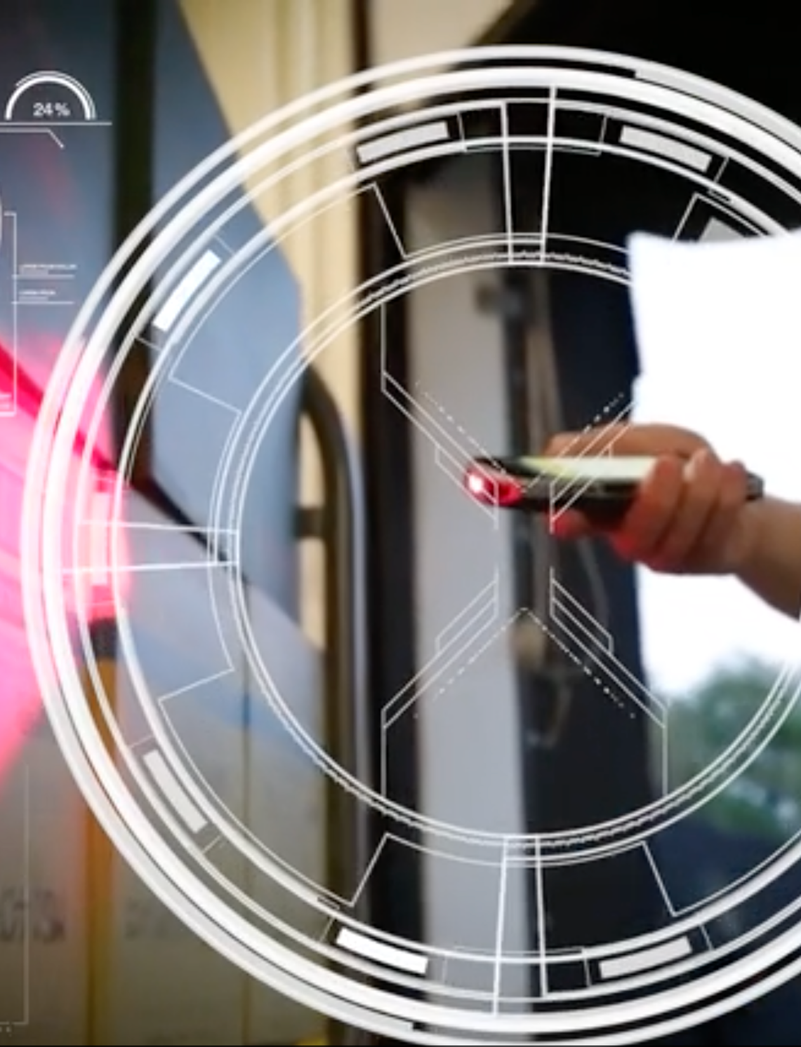
The Value of Location Technologies
The Right Questions to Understand Your Requirements
What problems are you are trying to solve?
E.g. visibility, measurability, and/or operational control?
What are the problems costing you?
E.g. in efficiencies, processes, supply chain activity, and inverse qualifiers?
How often do the problems occur? How are losses remedied?
Where do your “assets” go and how often?
What data do you need to gather? What KPIs?
ZEBRA TECHNOLOGIES

Slide 5
The Value of Location Technologies
Consider Location Variables
Point in Time
Gives an indication of location at a specific point in time
Persistence
Provides a continuous notification of location at user defined intervals
Presence
A tagged item is within range of something that can hear it
Proximity
A tagged item is in the proximity of a transmitter or receiver at a known location
Position
The exact position of a tagged item is determined independent of topology or known adjacent positions on a continuous basis
Primarily persistence
Can be point in time
or persistent
Always point in time

Slide 6
The Value of Location Technologies
Identify The Right Technologies For Your Needs
Passive RFID
Inexpensive Tags
1-8m Range
Medium Accuracy
Battery Life (n/a)
UWB
High Accuracy
200m Range
Highly Accurate
Long Battery Life
Bluetooth®
low-energy technology
Ease of Deployment
10m Range
Low Accuracy
Good Battery Life
Wi-Fi
Exists Everywhere
30m Range
Low Accuracy
Poor Battery Life
ISO 24730
Range and Difficult
RF Environments
400m Range
Medium Accuracy
Long Battery Life
GPS
Outdoor Accuracy
Worldwide Range
Low Accuracy
Poor Battery Life
ZEBRA TECHNOLOGIES General comparative guidelines, not absolute technology limits

Slide 7







The Value of Location Technologies
Compare Location Technologies
The Challenge
Understanding the problem(s) to solve, the business impacts, and the benefits resulting from a location-based solution
Choosing the best location technology
For complex issues, multiple technologies may be required. No one technology does it all
Sub-meter
UWB Technology
Location Accuracy
ISO 24730-2
WhereNet
Ultrasonic
Infrared
Meter
Accuracy
GPS
Wi-Fi
BLE
Zone
Other “Active RFID” Systems
Passive
RFID
NFC
Portal
Barcode
Data Output
Zebra works with almost
any location technology
Visual Scans
Tag Proximity/In
Reader's RF Field
Hours
Minutes
Seconds
Sub-seconds
Update Rates

Slide 8
The Value of Location Technologies
Evaluate Solution Variables
Range | Global vs 1 km vs 200 m vs 10 m vs 4 m
Accuracy | Subject to reflection/interference, time/angle/signal, and size of common error
Precision | 7 m vs 2.5 m vs 1 m vs 25 cm
Determinacy | Know every second, every 5 minutes, every time someone checks
Infrastructure | Existing (Wi-Fi), externalized (satellite/cellular), simple, complex
Deployment | Traditional cabling, receivers and antennas vs stick-up tags and an app
Battery Life | Recharge daily, replace batteries yearly, replace tags every 5-10 years
Interoperability | At the tags, at the reader/receiver, at the locate engine, above the middleware
Cost | Of the tag, of the infrastructure, of the deployment, of the maintenance
ZEBRA TECHNOLOGIES

Slide 9
02
Zebra Location Solutions Hardware & Use Cases

Slide 10
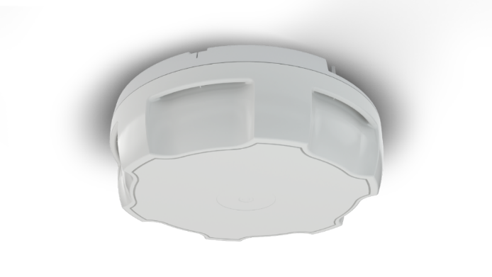

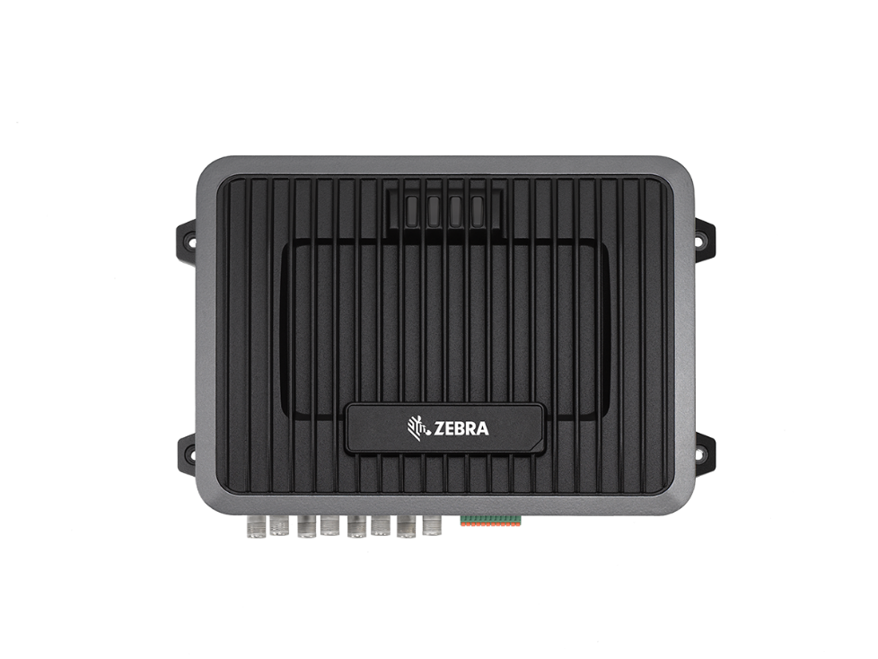
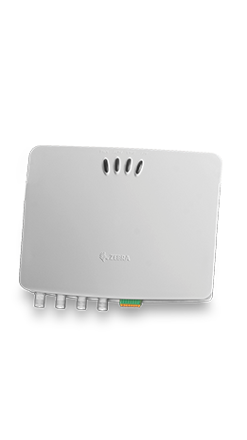
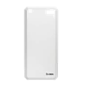



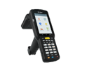
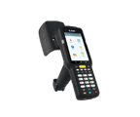

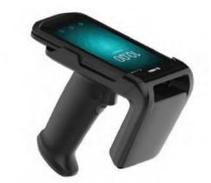
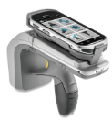
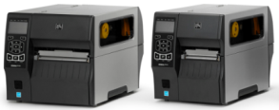
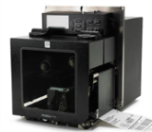
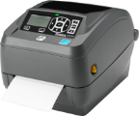
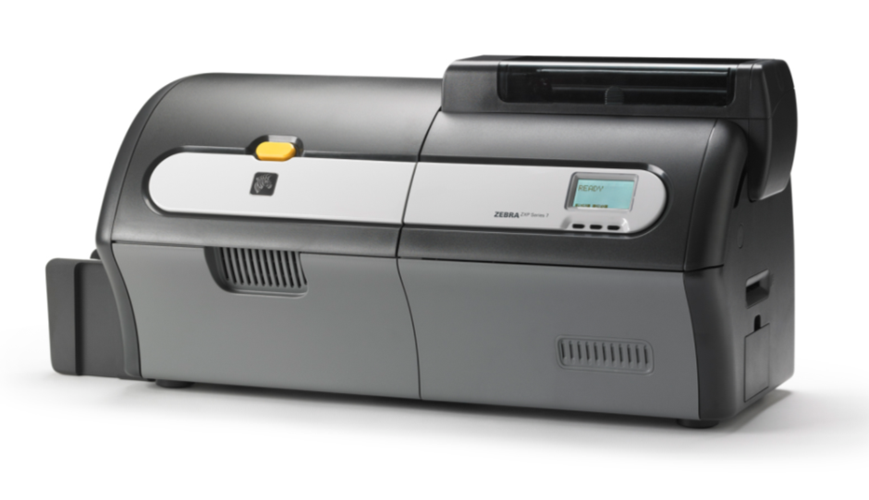
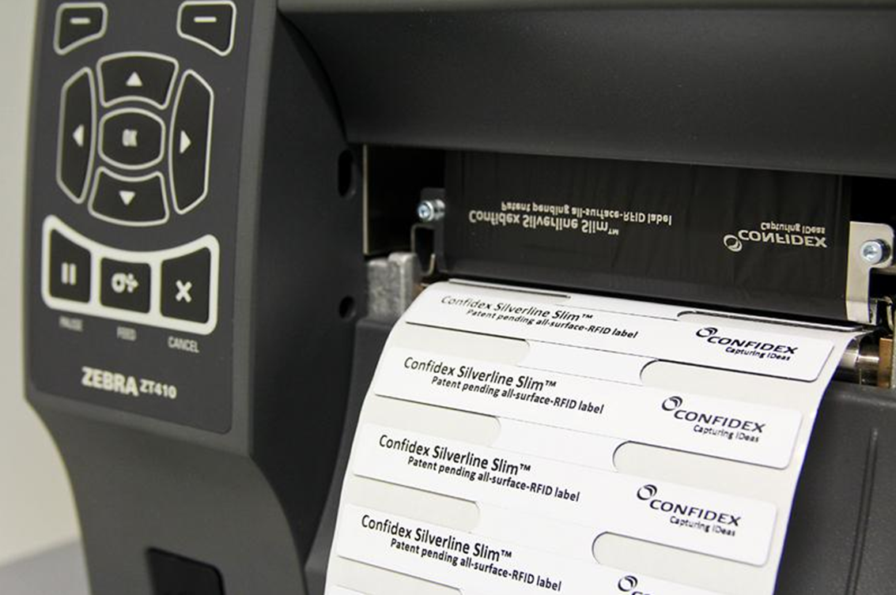
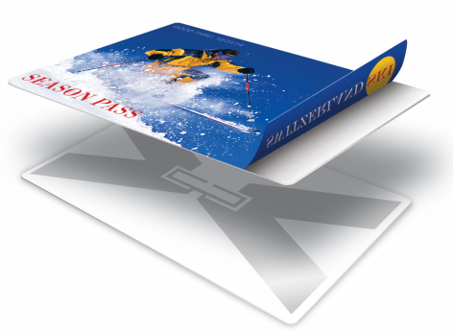
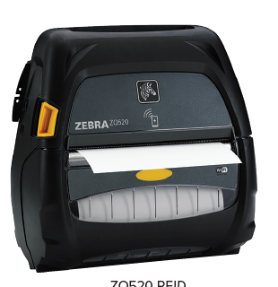
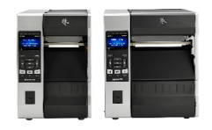
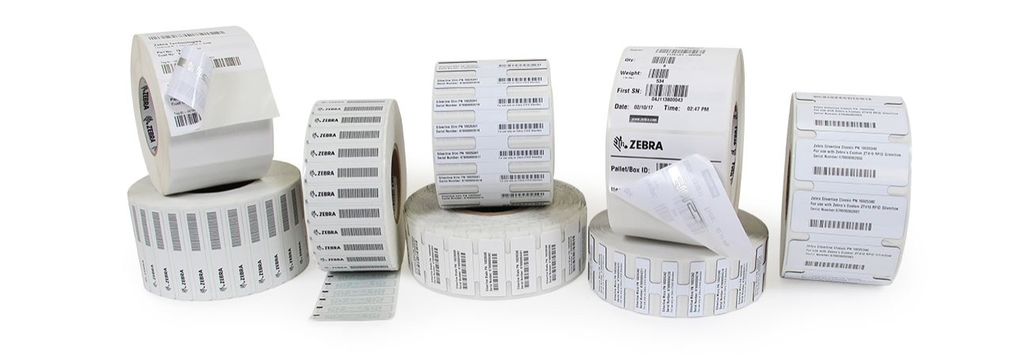
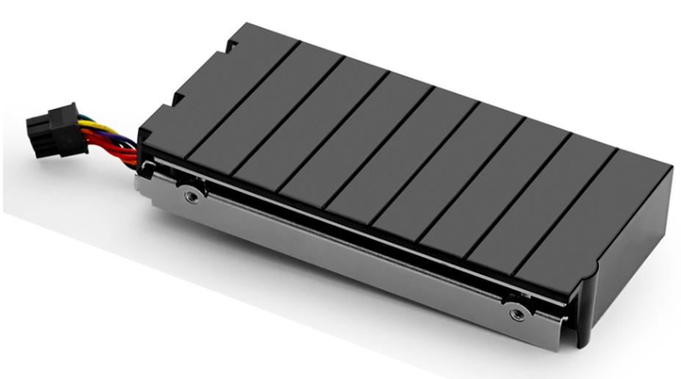
Zebra’s RFID Porfolio at a Glance
Widest range with one brand..!
ATR-7000
FIXED
READERS &
ANTENNAS
  FX9600
FX7500
AN440
AN480
AN600
AN710
ST5500
HANDHELD READERS
MC3330
MC3390
  RFD2000
  RFD8500
  DS9908R
PRINTER ENCODERS, LABELS & CARDS
ZT400R Series
ZE500R Engine
ZD500R
ZXP7 and UHF Card
On-metal RFID
ZQ520R/630R
ZT600R Series
RFID Upgrade Kits
RFID Labels

Slide 11
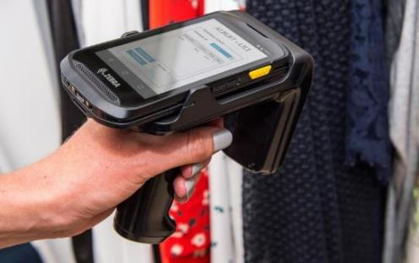
The RFID Value Proposition
Transform business processes with faster, more accurate data collection
Count quickly, easily, often
Read many items at once
Less Human Intervention
Precisely locate items and assets Now available
Increased Visibility
Greater Efficiency
Improved Accuracy
Improved Productivity
ZEBRA TECHNOLOGIES CONFIDENTIAL - 2018

Slide 12
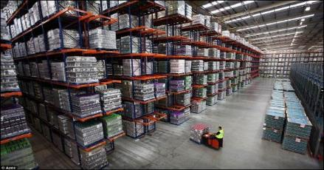
RFID Business Value
ASSET MANAGEMENT
Proven Business Benefits | Zebra & Partner Implementations
Improvement in inventory accuracy by | 30% to 60%
Inventory Accuracy | Between 95% & 99.9%
Reduction in Physical Count Time by | 50% to 90%
Reduced Inventory Carrying Costs by | 10% to 35%
Reduced Counting Man Hours | 20% to 45%
Reduction in Inventory On Hand | 5% to 20%
Reduction in Expedite Fees | 5% to 18%
Reduction in Operating Costs | From 1% to 5%
Employees can find what they need, when they need it
Increased customer satisfaction
Driving top line improvements
ZEBRA TECHNOLOGIES CONFIDENTIAL - 2018
Notes:
12

Slide 13
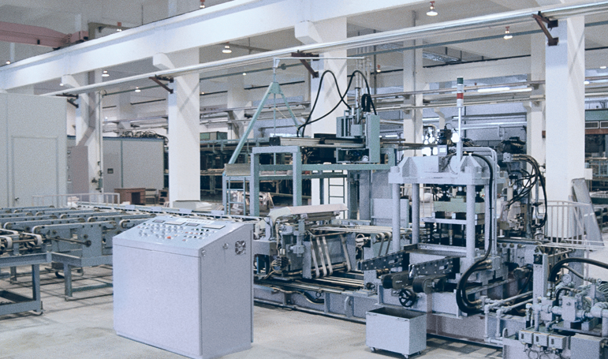
Ultra-Wideband Solutions (UWB)
Insights That Inspire Innovation
Designed with over 25 years of expertise, Zebra UWB products provide you with world-class accuracy in visibility solutions.
A real-time location solution (RTLS) that allows for a myriad of asset management applications
Accurately track personnel and equipment indoors and out
Low cost-of-ownership by improving installation ease, visibility, scalability, performance, asset tracking and tag management

Slide 14
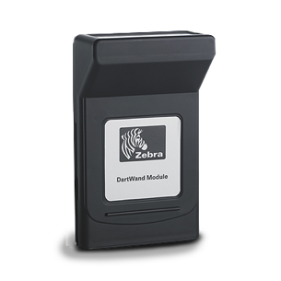
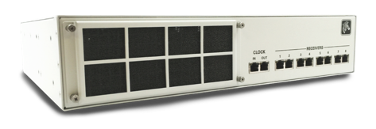
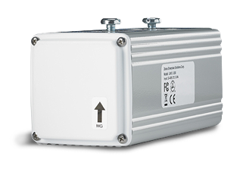
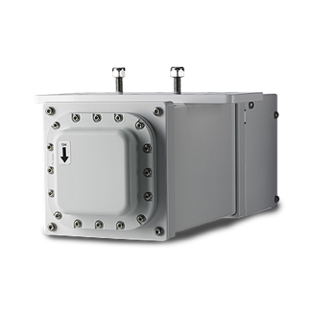
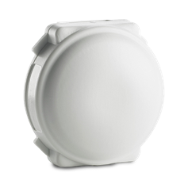
Ultra-Wideband
Solutions (UWB)
UWB Wand
UWB Hub
UWB Sensor
INDUSTRY USE
Transportation
Field Mobility
UWB Vision Reader
Manufacturing
Warehouse
Management
Location Solutions
UWB Tags

Slide 15
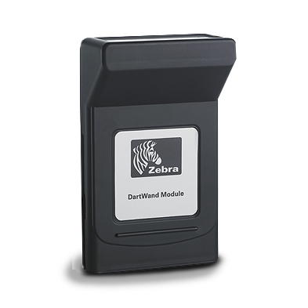

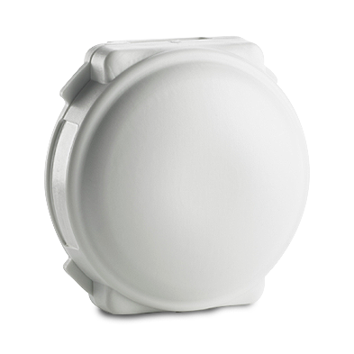
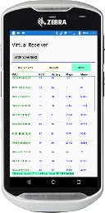
Zebra MotionWorks Asset Solution
Using UWB Products
Mobile & Fixed
Receiver Hardware and Software Applications
Location
Engine
Applications
Locations
Business Insight
Beacons and Tags
Backhaul
Communications
Cellular
Wi-Fi
Other Wired or Wireless
With range up to 300 ft Dart is accurate to 1-3 ft. Battery life is up to 7 years at 1 locate per second.

Slide 16

“The Official On-Field Player Tracking Provider” of the NFL
NFL Player Tracking Solution:
League-Wide Deployment

Slide 17
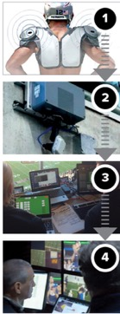
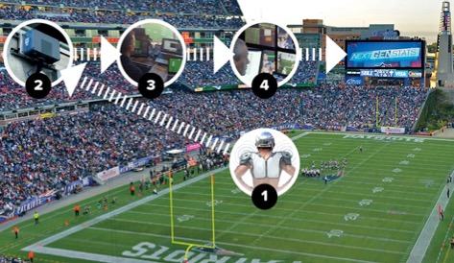

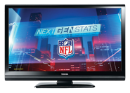


Zebra Sports GameDay Tracking Solution
TWO NICKEL-SIZED SENSORS THAT EMIT UNIQUE RADIO FREQUENCIES 25 TIMES PER SECOND
20 RECEIVERS MOUNTED BETWEEN UPPER & LOWER DECKS COLLECT DATA IN REAL-TIME
ALGORITHMS AGGREGATE PLAYERS’ STATS AND DISPLAY IT ON ANALYTICS SOFTWARE IN REAL-TIME
CREATION OF MOST ROBUST DATABASE IN SPORTS FOR REAL-TIME USE BY MEDIA PRODUCERS

Slide 18
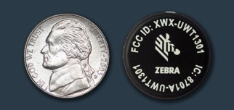

Zebra Sports GameDay Tracking Solution
ZEBRA PLAYER TAGS
ZEBRA INSTRUMENTED FOOTBALL
Size: Diameter < 1” Weight: 6.7 grams
  Zebra worked with Wilson to create an instrumented football, allowing teams to understand position relative to the ball and ball performance metrics during games and practices
        Smallest Form Factor In The Marketplace
        Low Touch Factor: Battery Lasts Entire Season
        Impact And Water Resistant

Slide 19
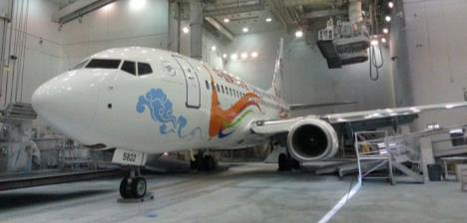
Solutions – People Tracking - Worker Safety
Application: paint hangar worker safety
  Painters work 30ft above concrete.
  Not all workers “clip into” retention line.
  Worker’s “climbing harness” has tags; retention line has a tag; if they get more than a foot apart, platform will not move.
  Locates are performed in 3D – detect workers under a platform before lowering.
  Use cases:
    Are my workers “clipped in”
    Is there a worker beneath a platform?
  Solution components:
    DART tags, receivers, hub
    MotionWorks (similar to MW-Sports)
In the paint hangar, hydraulic platforms get the workers up close to the plane. Note that there is no railing on the platform’s leading edge.
Painters wear a “bunny suit”, respirator, and work in a cloud of paint; it would be easy to step off that front edge.

Slide 20
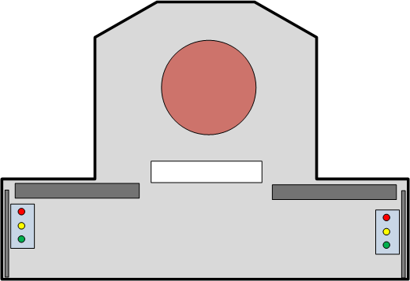

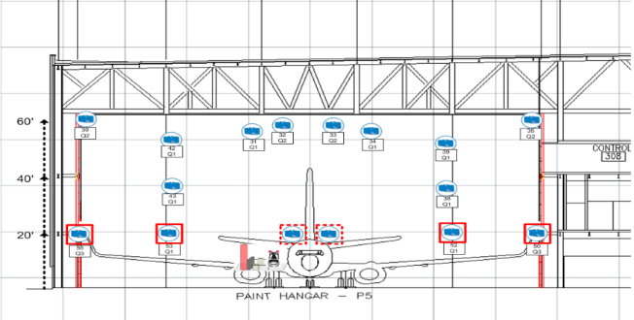
Fall Protection System
DART UWB with MotionWorks
Real-Time Dynamic Tag Tracking
  Self-Retracting Lifeline
  Safety Harness
  Stacker
Stacker Boundaries Created by Tag Locations
  Proximity of Harness & Stacker
  Proximity of Harness & SRL
  Stacker Movement: Enabled or Disabled
SRL
1
SRL
2

Slide 21
Solutions – Asset Tracking
Application : Asset Tracking
  Need to track every tool, rack, component for JIT workflow process on production floor. Also provide tracking outside at the flight line hangers for operations.
  Currently providing visibility in 50+ buildings.
  Use cases:
    Where are my assets?
    Provide asset information for JIT workflow
  Solution components:
    DART tags, receivers, hub

Slide 22
Use Case: UWB Asset Tracking
USE CASE
Asset Visibility
Customer was using proximity location visibility of both blocks and engines provided by a passive RFID system that detects movement of the J-Hook and other line transport mechanisms. This does not provide the level of visibility required.
Zebra Technologies proposed Zebra MotionWorks Asset Visibility solution to address visibility of both blocks and engines with an initial focus on the out of process and shipping workflows.
Root cause of loss of visibility
Inspection, audit, part or assembly issues, this forces a visual inventory process that is complicated by dynamic movement from the lines and block work areas to include rework, quality inspection, staging and holding areas.
Example of Temporary Out of Process Staging
Immediate Benefits
Real-time location tracking of engines on a digital plant layout map. Increase efficiency of engine search and thus reduce labor time.
Beneficial to Quality allows quick identify the location of a population of engines for inspection and repair campaigns.
Quality will be able to locate the physical location of engines that are in a dockhold.
Real-time location tracking of engine population for ECM reflash at the back-dock.
Real-time engine inventory in the plant. This could include the real-time inventory location of engines coming back for repair from FCA (light integration with AMS/Excel).
Determine age of engines in Repair, Test and the back-dock.
Value Proposition:
Cost savings on manual inventory process (walking entire plant looking for specific block) $125K per year
Lost engines (approx. 52 in 2019 average 40 per year) $500K+
Example of Shipping Area Staging

Slide 23
Solutions – Tool Control
Application : use the right tool on the car
  Seven locations.
  Track cars moving down the line.
  Track tools on the line.
  Integrates to Siemens Smart Factory SW.
  Use cases:
    Energize correct tool for this particular car
  Solution components:
    2000+560 DART tags
    422+182 DART receivers
    10+5 DART hubs
    VSS

Slide 24
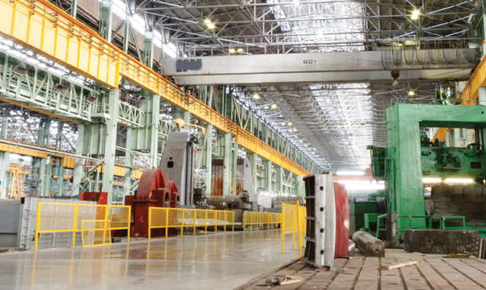
WhereNet Real-Time Locating System
Asset and Personnel Tracking
Designed for all environments, including complex and hazardous ones
Uses 2.4GHz direct sequence spread spectrum for broad global compatibility, long range, and reliable results
Receivers sense one-way "blinks” or transmissions from active tags, time stamps them, and forwards them to the location engine to be turned into location data

Slide 25
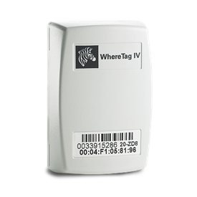
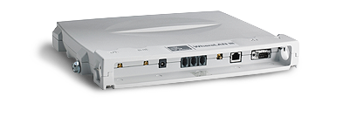
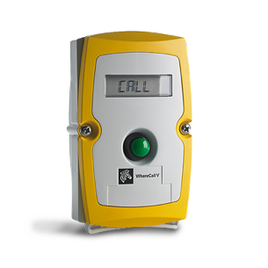
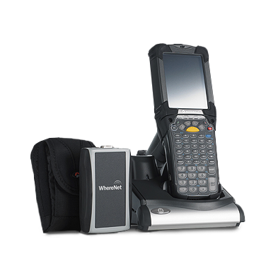
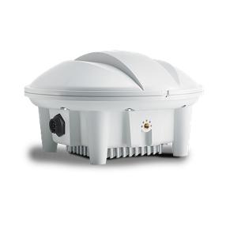
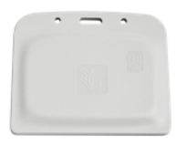
WhereNet Real-Time
Locating System
WhereTag
WhereLAN
WhereCall
INDUSTRY USE
WhereWand
Field Mobility
WherePort
Location Solutions
WhereNet Badge Tag
Warehouse Management

Slide 26

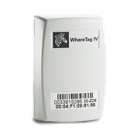
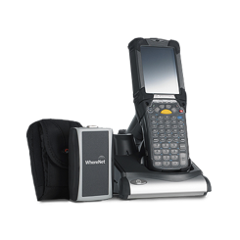
Zebra MotionWorks Asset Solution
Using WhereNet Products
Mobile & Fixed
Receiver Hardware and Software Applications
Location
Engine
Applications
Locations
Business Insight
Beacons and Tags
Backhaul
Communications
Cellular
Wi-Fi
Other Wired or Wireless
With range up to 1,000 ft WhereNet is accurate to 3-6 ft. Battery life is up to 10 years
ZEBRA TECHNOLOGIES

Slide 27
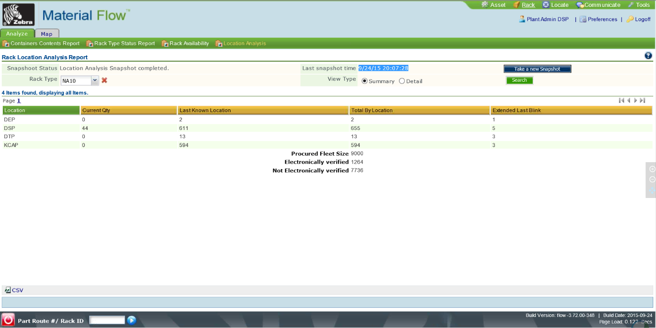
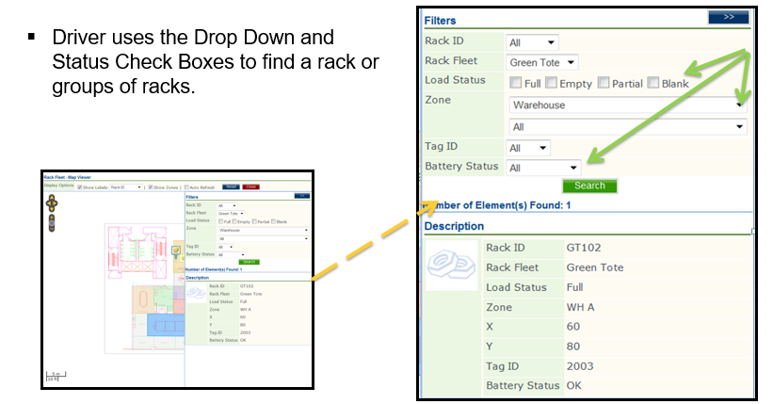
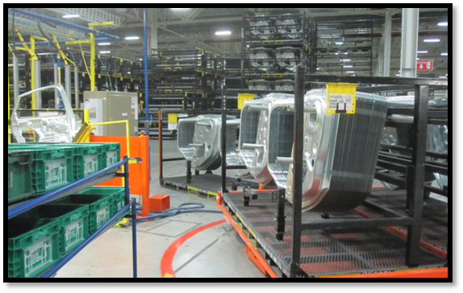
Solutions – Asset Visibility – Rack Tracking
Track and manage all your important assets with Zebras Rack Tracking Enterprise solution, which provides you detailed on-time information about the location, condition, and state of your enterprise resources
Features & Benefits
  Designed to support global-scale enterprises to provide you with complete visibility of Ford WIP Racks
  Works with WhereLan location sensing technologies to provide you the most on-time or real-time accurate data automatically – reducing or eliminating manual audit and verification
  Configurable alerts and reports let you better manage service calls, issues, as well as aging and dwell times for your serviceable assets

Slide 28
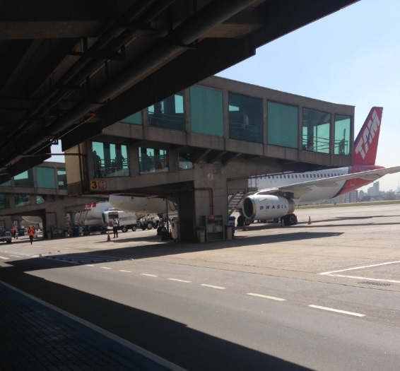

Solutions – Asset Visibility – Airport Equipment
Tracking Airport Tugs or High Dollar Assets
  With combo GPS + WhereNet tags, track airport tugs outdoors & under roof.
  2 Airports installed; preparing to roll out next 22 sites.
  US airlines also interested; planning pilots at 4 US airports.
  Use cases:
    Where is a particular tug or truck?
  Solution components:
    WhereNet GPS tag
    WhereNet infrastructure

Slide 29



Solutions – Asset Visibility – Vehicle Tracking
Track Car Manufacturing
  Production and staging for auto manufacturers, and service tracking for High-end auto service centers and aftermarket specialty companies.
  Use cases:
    Where is particular car?
  Solution components:
    WhereTag, WhereNet
    Passive RFID
    Partner Software

Slide 30





Zebra’s Real-Time Location Solution
RFID Vehicle Tracking System
Each unit “Tagged” on assembly line
Rule-Based processing plan updated continuously
System monitors / verifies unit meets all process steps
Tag removed & recycled at ship point
Notes:
Track vehicle location in the yard, work completion, WIP amounts

Slide 31

Zebra’s Real-Time Location Solution
RFID Vehicle Tracking System
Every Dot is a Vehicle
in a Parking Space
Notes:
Track vehicle location in the yard, work completion, WIP amounts

Slide 32





Solutions – Material Replenishment
Manage and automate the flow of materiel for line-side replenishment, scrap disposal, work in process and more with Zebras Materiel Flow solution
Features & Benefits
  Wireless with real-time location so you don’t have to worry about wiring, power, line reconfiguration, downtime
  Prioritized assignment and dynamic routing assures the right parts get to the right place at the right time
  Immediate collection of demand improves supply chain accuracy and plant inventory visibility and can reduce inventory carrying costs substantially and expedite fees
  Identification of the demand location improves routing and efficiency, reducing wasted trips, traffic, and the chance of line stoppage
  Real-time understanding of inventory and WIP support Part traceability
  Automated QA process for inventory disposition, scrap management, and vendor rejects and our supplier portal support improve your ability to deal with non-conforming material
Notes:
Some customers see reductions in certain labor costs of 15-20%, reductions in excess inventory of 5-10%, and increases asset utilization of 5-10%
Internal Supply
Eliminates line stoppages due to parts shortages
Applies priority and directs the right driver to deliver materials
Minimizes materials and traffic on the floor
Reduces line configuration time and cost
External Supplier Portal
Provides real time visibility of consumption beyond the 4 walls
Communicates demand and fulfillment information bi-directionally

Slide 33

Bluetooth® Low-Energy Beacon Technology
Precision Tracking For Indoor Location Tracking
Using low-energy technology, they are easy to deploy with a wide range of applications to make your business more competitive and profitable
The best real-time location solution when you need inexpensive devices capable of tracking down to a small zone or within a room

Slide 34






Bluetooth® Low-Energy Technology
MB1000 Asset Beacon
MB2000 Indoor Beacon
SB2000 Enhanced Indoor Beacon
MB2001 Indoor Beacon
INDUSTRY USE
MB3000 Indoor Beacon
Healthcare
Warehouse Management
MB4000 Outdoor Beacon
Transportation
Manufacturing
IoT Bluetooth Bridges
Location Solutions
Retail

Slide 35






Zebra MotionWorks Asset Solution
Using Bluetooth® Products
Mobile & Fixed
Receiver Hardware and Software Applications
Location
Engine
Applications
Locations
Business Insight
Beacons and Tags
Backhaul
Communications
Cellular
Wi-Fi
Other Wired or Wireless
BLE accuracy depends on installation density and configuration and varies from +/- 2 to 10m. Battery life is up to 4 years, with update rates every 0.1 to 5 seconds.
ZEBRA TECHNOLOGIES

Slide 36





Case study: Load Compliance

Slide 37
03
Motionworks Software Platform

Slide 38



Zebra Technologies was recognized as a Leader in Gartner, Inc.’s 2020 Magic Quadrant for Indoor Location Services, Global*
This is the first year Gartner has placed a company in a Leader position. Zebra has been recognized as a Visionary for each of the last two years.
Read a complimentary copy of the report here:
www.zebra.com/gartnermq2020
*Gartner, Inc., "Magic Quadrant Indoor Location Services, Global," Tim Zimmerman, Annette Zimmermann, 13 January 2020. This graphic was published by Gartner, Inc. as part of a larger research document and should be evaluated in the context of the entire document. The Gartner document is available upon request from Zebra Technologies. Gartner does not endorse any vendor, product or service depicted in its research publications, and does not advise technology users to select only those vendors with the highest ratings or other designation. Gartner research publications consist of the opinions of Gartner's research organization and should not be construed as statements of fact. Gartner disclaims all warranties, expressed or implied, with respect to this research, including any warranties of merchantability or fitness for a particular purpose. GARTNER is a registered trademark and service mark of Gartner, Inc. and/or its affiliates in the U.S. and internationally, and is used herein with permission. All rights reserved.

Slide 39








Zebra MotionWorks captures data and transforms it into information to provide insights such as:
Information to help solve the problems unique to your business
Visibility of goods, assets and people
Asset location and usage
Measurability of business practices
Workforce compliance
Operational control
ZEBRA TECHNOLOGIES
Supply chain activity visibility

Slide 40

MotionWorks
MotionWorks can track anything – assets, goods and people – resulting in loads of information that can impact your business
Motionworks takes that data and transforms it into usable and impactful insights
Using proven algorithms and rules engines it derives actionable information and business context from the location data being gathered

Slide 41















MotionWorks Solution Stack
MC & Tablets
Business Application
(Zebra and 3rd Party Business Solutions:
UI/UX, Business Workflows, Dashboard,
Maps, Alerts, Reports)
Asset Tracking
Material Flow
Yard Management
IT Asset & Tool Tracking
Medical Eqp Mgmt
Warehouse
Location Software
(Data aggregation, business rules engine,
application integration framework)
Zebra Signature Services
(Discovery, Design, Implementation,
SW & Data
Integration, Training)
Location Engine
Location Engine Lite
(pRFID, BLE)
1D and 2D Barcode
Passive RFID
Wherenet
ISO/IEC 24730-2
Dart
Ultra Wideband
GPS
BLE
Sensing Hardware
(Location & identification infrastructure)
Notes:
Application Layer: UI/UX, Dashboard, Maps, Alerts, Reports (can be provided by Zebra, customer, or Partner
Data Service Layer: Application integration Framework for Data services/APIs (eg Location API, Fullness API)
Platform: Collecting data from sensing technology, data aggregation, applies business context, business rules specification/configuration, event engine to process rules, db, CMM
Sensing HW: Collects presence, location or payload data on a thing that is tagged

Slide 42









MotionWorks Enterprise
Visualisation and Mapping
  Enterprise
  Customizable reports
  Resource Alerts
  Data Import and Export
  Role Based Access Control

Slide 43







Motionworks Enterprise– Core Functions
Reporting & Data Entry
Enterprise Connectors
Visualisation and Mapping
Historical data
Savanna Location Engine
Alert & Monitoring
Dwell and Cycle Time Measurement
AutoID Device Connectors
Configuration Tools (Zones, Groups)

Slide 44


MotionWorks Enterprise – Tools
An extensive suite of tools is included:
  System Designer
  Model and predict operation
  Installation
  Configuration
System Builder or Site Manager:
  Map Creation
  Device configuration to include location
  RTLS and fixed passive RFID system configuration
Zone Builder
  Zone Group Creation
  Zone Creation
Configuration Tools (Zones, Groups)

Slide 45


Slide 46


MotionWorks Enterprise – What does it look like?
Notes:
Basic Dashboards for system and resources today

Slide 47

MWE > Report and Map

Slide 48

MWE > History > Location History Single and Multiple Playback

Slide 49





Kibana
Easy to use browser-based visualization tool with interactive charts and reports
 | MAPPING SUPPORT Capability to layer in geographical information on top of your data and visualize results on maps.
 | PRE-BUILT AGGREGATIONS AND FILTERS The ability to run a variety of analytics like histograms, top-N queries, and trends with just a few clicks.
 | DASHBOARDS Easily set up dashboards and reports and share them with others – all that’s needed is a browser to view and explore the data.
Notes:
Kibana is browser-based visualization tool used to analyze large volume of logs in the form of line graph, bar graph, pie charts, heat maps, region maps, coordinate maps, gauge, goals, timelion, etc.
The visualization makes it easy to predict or to see the changes in trends of errors or other significant events of the input source.

Slide 50




With Zebra MotionWorks, you can track assets
AT ANY VOLUME We’ve deployed location beacons for major shipping companies to track their packages
AT ANY SPEED
We follow the exact speed and position of footballs and players during NFL games in real-time, enabling Next Gen Stats
AT ANY SCALE
We can add a small amount of tracking to your facility now, and you can add more as needs and applications emerge
WITH INCREDIBLE
FLEXIBILITY & CUSTOMIZATIONWe can integrate data from multiple 3rd-party sources, not just Zebra supplied ones

Slide 51
04
Next Steps

Slide 52
Discovery Workshop
Key Features
Review of Customer’s existing business processes and technical architecture
Understand Customer’s goals to be achieved with the MotionWorks solution.
Document Customer’s current processes and workflows
Gap analysis / review of current state of architecture
Document a MotionWorks Solution to achieve their goals and roadmap for 1 /3 /5 years per Customer requirements.
Develop an actionable plan to move through the design phase of the MotionWorks solution
Learning Assessment to determine the customers goals for learning and user adoption.
Results
Documentation of customer’s current systems and processes
Documentation Objectives and Expectations of the Solution
Overview of proposed solution
Systems Diagrams
Solution Process Recommendations
Process and workflow Recommendations
Solution Components
System Interfaces

Slide 53








Why choose Zebra and Logic
DASHBOARDS
REPORTS
DATA ANALYTICS
THE CLOUD
DEVICES
APPLICATIONS

